Slide 1

STATISTICAL AND MATHEMATICAL FOUNDATIONS
data-action-lab.com

Slide 2
MODULE LEARNING OBJECTIVES
In this module, we provide, in very broad terms, some fundamental mathematical and statistical background required for data analysis and model building with practical applications.
Participants will become acquainted will key concepts, to allow for future learning.
This introduction is not meant to replace formal training and is at best incomplete; please consult the references for further details.

Slide 3
OUTLINE
Modeling
Distributions
Central Limit Theorem
Estimation
Bayes’ Theorem
Matrix Algebra
Eigenvalues and Eigenvectors
Regression
Optimization

Slide 4
MODELING
STATISTICAL AND MATHEMATICAL FOUNDATIONS

Slide 5
LEARNING OBJECTIVES
Understand the difference between modeling from first principles and statistical modeling.
Working knowledge of the modeling process.
Increase awareness of modeling pitfalls and challenges.

Slide 6


[http://dailycatdrawings.tumblr.com; #309]
Real World
Model
Theory
Identification of details relevant to description and translation of real-world objects into model variables

Slide 7
Models in General
First principles modeling
examine a system
write down a set of rules/equations that describe the essence of the system
ignore complicating details that are “less” important
Statistical modeling
typically a set of equations with parameters
parameters are learned (model is “trained”) using multiple data observations
data sample vs. population

Slide 8
Modeling HEURISTICS
In a sense, modeling is a straightforward (and formulaic?) process, guided by intuition and experience at each step.
Basic steps in building a statistical model:
defining the goals
- what are we trying to achieve?
- under what situations will the model be used and what is the outcome we are trying to predict?
gathering data
- what data is available?
- how many records will we have?
- generally, modelers want as much data as possible

Slide 9
Modeling HEURISTICS
Basic steps in building a statistical model: (continued)
deciding on the model structure
- should we run a linear regression, logistic regression, or a nonlinear model? Which kind?
- choices of model structure require experience and deep knowledge of the strength and weaknesses of each technique
preparing the data
- assemble data into appropriate form for the model
- encode the data into inputs, using expert knowledge as much as possible
- separate the data into the desired training, testing, and validation sets

Slide 10
Modeling HEURISTICS
Basic steps in building a statistical model: (continued)
selecting and removing features
- variables are examined for model importance and selected or eliminated
- a list of candidate appropriate variables are ordered by importance
building candidate models
- begin with baseline linear models and try to improve using more complex nonlinear models
- keep in mind the environment in which the model will be implemented
finalizing the model
- select among the candidates the most appropriate model to be implemented
implementing and monitoring
- embed the model into necessary system process; implement monitoring steps to examine the model performance

Slide 11
Modeling Pitfalls
Common pitfalls surrounding the modeling process:
defining the goals
- lack of clarity around problem definition
- lack of understanding of how and where the model will be used
gathering data
- using data that is too old or otherwise not relevant going forward
- not considering additional key data sources or data sets that might be available
deciding on the model structure
- using a modeling methodology that is not appropriate for the nature of the data (sizes, dimensions, noise…)

Slide 12
Modeling Pitfalls
Common pitfalls surrounding the modeling process: (continued)
preparing the data
- not cleaning or considering outliers
- not properly scaling data
- not giving enough thought to building special expert variables
- not having data from important categories of records
selecting and eliminating features
- keeping too many variables, making it hard for modeling, interpretation, implementation, or model maintenance
- too much reliance on simply eliminating correlated variables

Slide 13
Modeling Pitfalls
Common pitfalls surrounding the modeling process: (continued)
building candidate models
- overfitting
- not doing proper training/testing as one examines candidate models
- not doing a simpler linear regression to use as baseline
finalizing the model
- not rebuilding the final model optimally using all the appropriate data
- improperly selecting the final model without consideration to some implementation constraints
implementing and monitoring
- errors in implementation process: data input streams, variable encodings, algorithm mistakes
- not monitoring model performance

Slide 14
DISTRIBUTIONS
STATISTICAL AND MATHEMATICAL FOUNDATIONS

Slide 15
LEARNING OBJECTIVES
What questions can you use to help you pick a model distribution for a data feature?
What are some commonly encountered pdfs?
What are the mean and variance of some common pdfs?
When do we need to use joint distributions?

Slide 16
Data and Distributions
If a data feature can be characterized by a distribution, consider asking four basic questions:
Can the variable only take on discrete values? continuous values?
whether a taxpayer’s file is audited or not is a discrete variable but the corrected amount from the audit is a continuous variable
Is the data distribution symmetric?
If not, in which direction does the asymmetry lie?
Are right- and left-outliers equally likely?

Slide 17
Data and Distributions
Does the variable have theoretical upper and lower limits?
Some items like age or height cannot be smaller than zero
Some items like operating margins cannot exceed a value (100% in this case)
How likely is it to observe extreme values in the distribution?
in some data, extreme values occur infrequently whereas in others, they occur more often
How would these questions have to change when dealing with joint distributions?

Slide 18
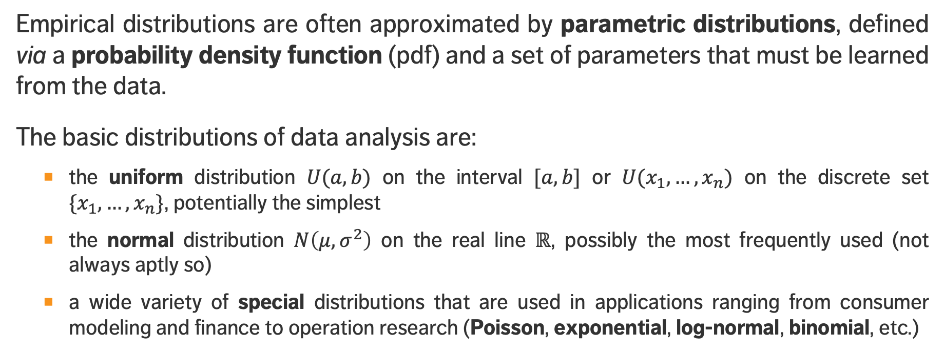
Fundamental Distributions
Empirical distributions are often approximated by parametric distributions, defined via a probability density function (pdf) and a set of parameters that must be learned from the data.
The basic distributions of data analysis are:
the uniform distribution $U(a,b)$ on the interval $[a,b]$ or $U(x_{1},…,x_{n})$ on the discrete set $\{x_{1},…,x_{n}\}$, potentially the simplest
the normal distribution $N\left(μ,σ^{2}\right)$ on the real line $ℝ$, possibly the most frequently used (not always aptly so)
a wide variety of special distributions that are used in applications ranging from consumer modeling and finance to operation research (Poisson, exponential, log-normal, binomial, etc.)

Slide 19
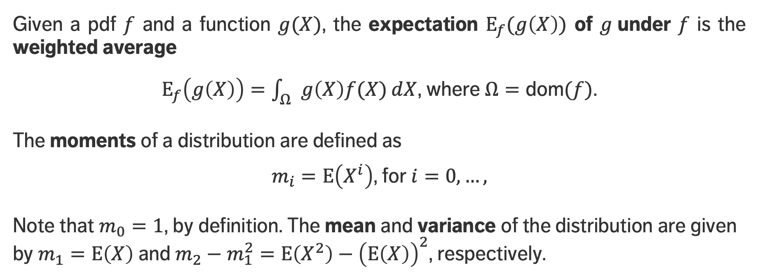
Expectation and Moments
Given a pdf $f$ and a function $g(X)$, the expectation $E_{f}(g\left(X\right))$ of $g$under $f$ is the weighted average
$E_{f}\left(g\left(X\right)\right)=\int_{Ω}{g\left(X\right)f(X)ⅆX}$, where $Ω=\text{dom}(f)$.
The moments of a distribution are defined as
$m_{i}=E\left(X^{i}\right)$, for $i=0,…,$
Note that $m_{0}=1$, by definition. The mean and variance of the distribution are given by$m_{1}=E\left(X\right)$ and $m_{2}−m_{1}^{2}=E\left(X^{2}\right)−{\left(E\left(X\right)\right)}^{2}$, respectively.

Slide 20
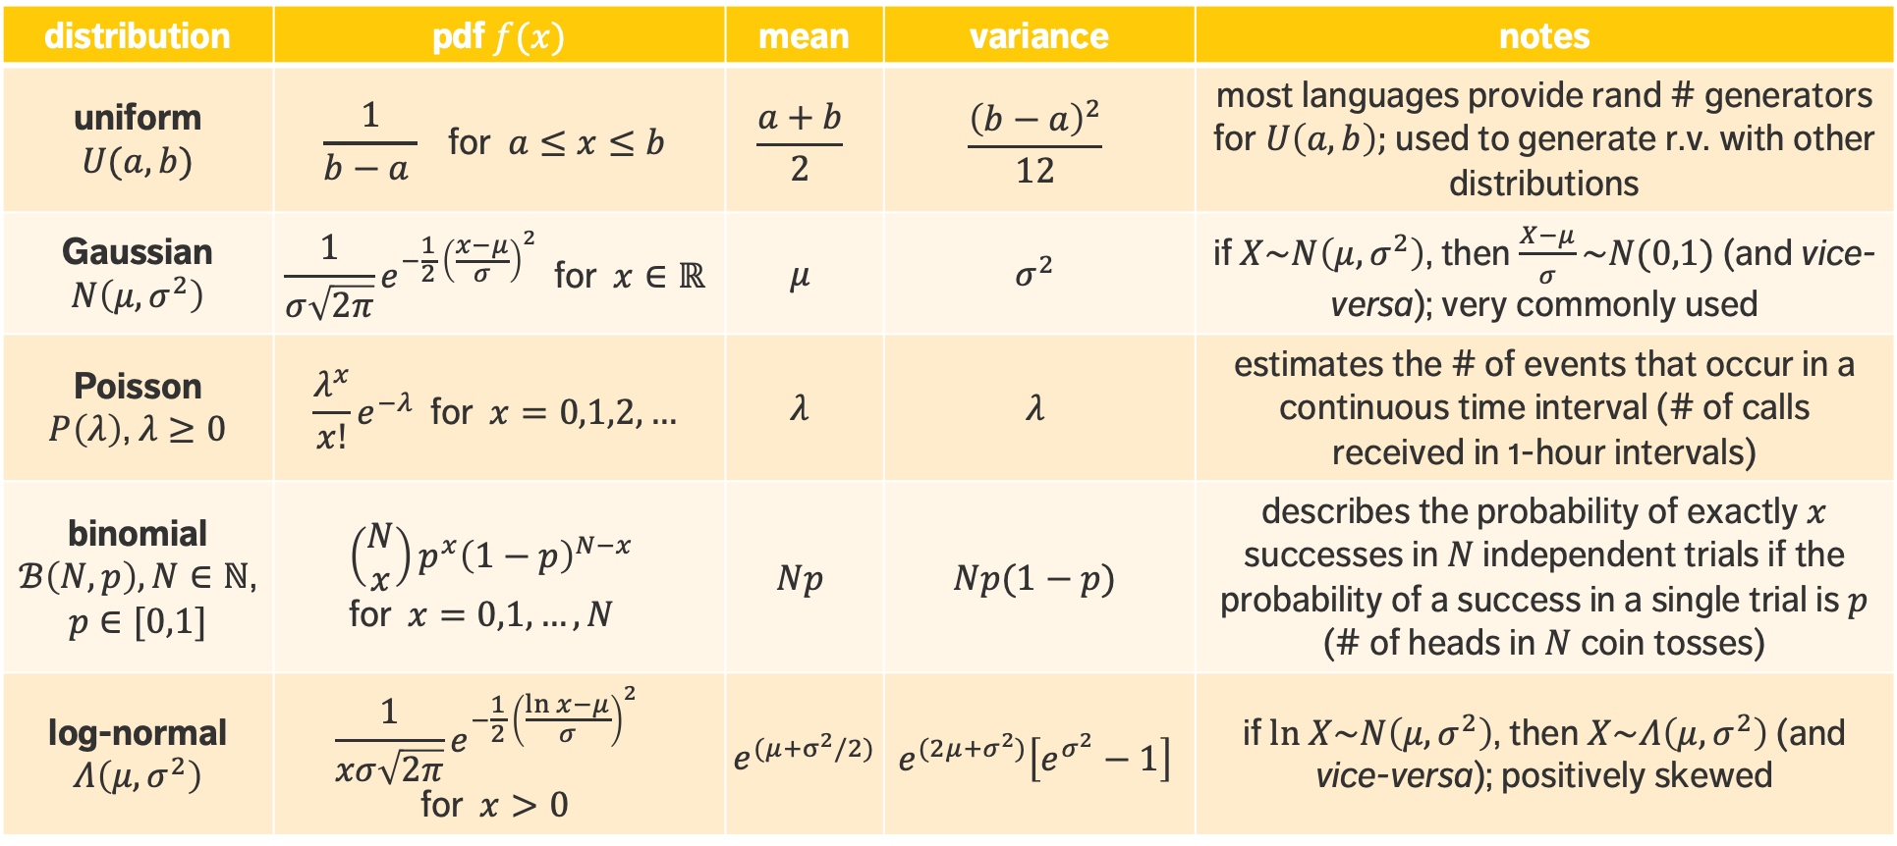
distribution | pdf $f(x)$ | mean | variance | notes
uniform $U(a,b)$ | $$\frac{1}{b−a } \text{for} a≤x≤b$$ | $$\frac{a+b}{2}$$ | $$\frac{{\left(b−a\right)}^{2}}{12}$$ | most languages provide rand # generators for $U\left(a,b\right);$ used to generate r.v. with other distributions
Gaussian $N\left(μ,σ^{2}\right)$ | $$\frac{1}{σ\sqrt{2π}}e^{−\frac{1}{2} {\left(\frac{x−μ}{σ}\right)}^{2}} \text{for} x∈ℝ$$ | $$μ$$ | $$σ^{2}$$ | if $X\sim N\left(μ,σ^{2}\right)$, then $\frac{X−μ}{σ}\sim N(0,1)$ (and vice-versa); very commonly used
Poisson $P\left(λ\right)$, $λ≥0$ | $$\frac{λ^{x}}{x!}ⅇ^{−λ} \text{for} x=0,1,2,…$$ | $$λ$$ | $$λ$$ | estimates the # of events that occur in a continuous time interval (# of calls received in 1-hour intervals)
binomial $ℬ\left(N,p\right),N∈ℕ$, $p∈[0,1]$ | $$\left(\begin{matrix}N \\ x\end{matrix}\right)p^{x}{\left(1−p\right)}^{N−x} \\ \text{for} x=0,1,…,N$$ | $$Np$$ | $$Np(1−p)$$ | describes the probability of exactly $x$ successes in $N$ independent trials if the probability of a success in a single trial is $p$ (# of heads in $N$ coin tosses)
log-normal $Λ\left(μ,σ^{2}\right)$ | $$\frac{1}{xσ\sqrt{2π}}e^{−\frac{1}{2} {\left(\frac{ln x−μ}{σ}\right)}^{2}} \\ \text{for} x>0$$ | $e^{(μ+σ^{2}/2)}$ | $$e^{(2μ+σ^{2})}\left[e^{σ^{2}}−1\right]$$ | if $ln X\sim N\left(μ,σ^{2}\right)$, then $X\sim Λ\left(μ,σ^{2}\right)$ (and vice-versa); positively skewed

Slide 21
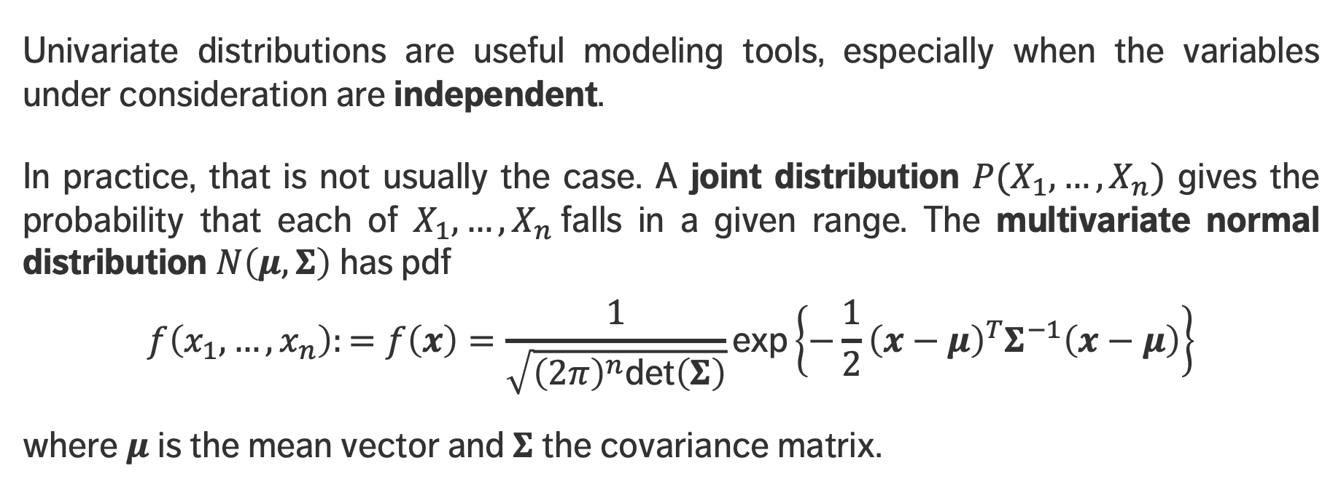
Joint Distributions
Univariate distributions are useful modeling tools, especially when the variables under consideration are independent.
In practice, that is not usually the case. A joint distribution $P(X_{1},…, X_{n})$ gives the probability that each of $X_{1},…, X_{n}$falls in a given range. The multivariate normal distribution $N\left(μ,Σ\right)$ has pdf
$$f\left(x_{1},…, x_{n}\right):=f\left(x\right)=\frac{1}{\sqrt{{\left(2π\right)}^{n}\text{det}\left(Σ\right)}}\text{exp}\left\{−\frac{1}{2}{\left(x−μ\right)}^{T}Σ^{−1}\left(x−μ\right)\right\}$$
where $μ$ is the mean vector and $Σ$ the covariance matrix.

Slide 22
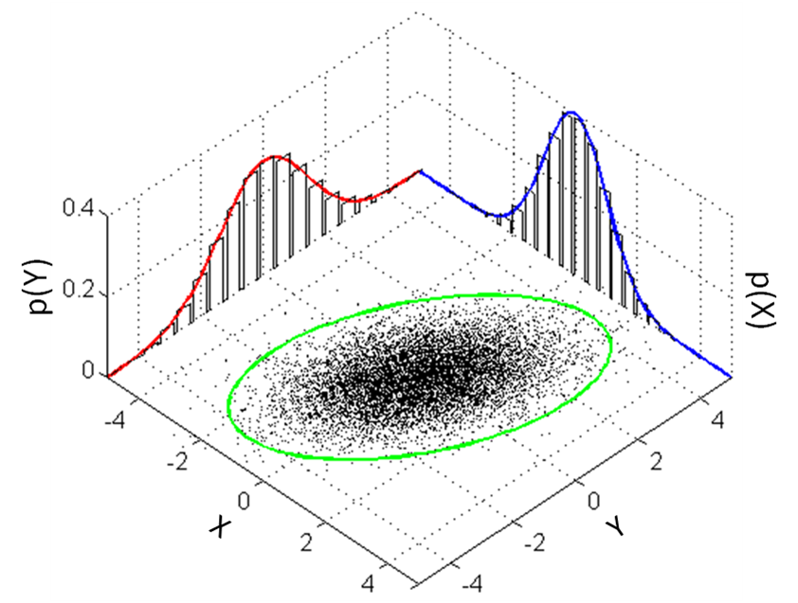

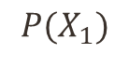
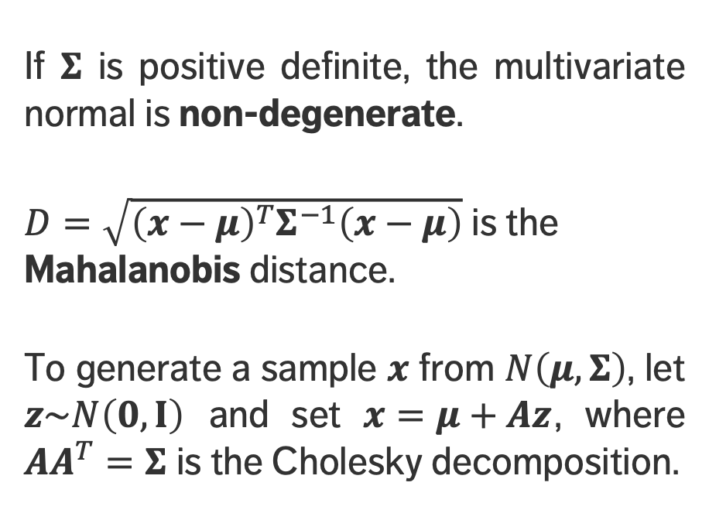
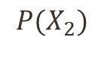
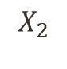
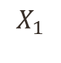
Joint Distributions
[image taken from Wikipedia]
If $Σ$ is positive definite, the multivariate normal is non-degenerate.
$D=\sqrt{{\left(x−μ\right)}^{T}Σ^{−1}\left(x−μ\right)}$ is the Mahalanobis distance.
To generate a sample $x$ from $N\left(μ,Σ\right)$, let $z\sim N\left(0, I\right)$ and set $x=μ+Az$, where $AA^{T}=Σ$ is the Cholesky decomposition.
$$P(X_{1})$$
$$P(X_{2})$$
$$D^{2}≤χ_{2}^{2}(0.95)$$
$$X_{1}$$
$$X_{2}$$

Slide 23
EXERCISES
Write R and/or Python code that lets you draw “random” samples from the various distributions discussed in this section.

Slide 24
CENTRAL LIMIT THEOREM
STATISTICAL AND MATHEMATICAL FOUNDATIONS

Slide 25
LEARNING OBJECTIVES
What is the central limit theorem?
When is the central limit theorem relevant?

Slide 26
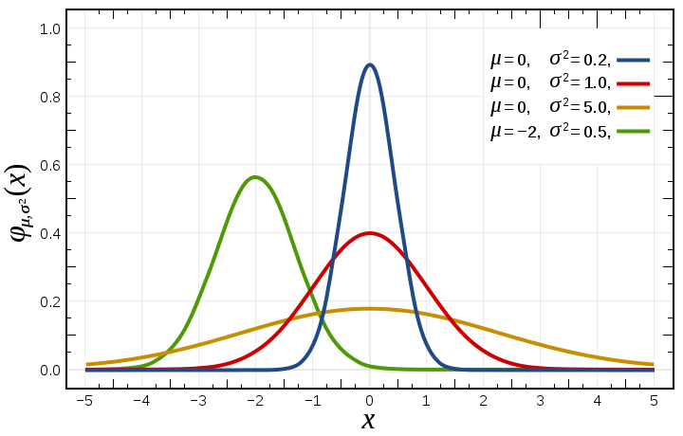
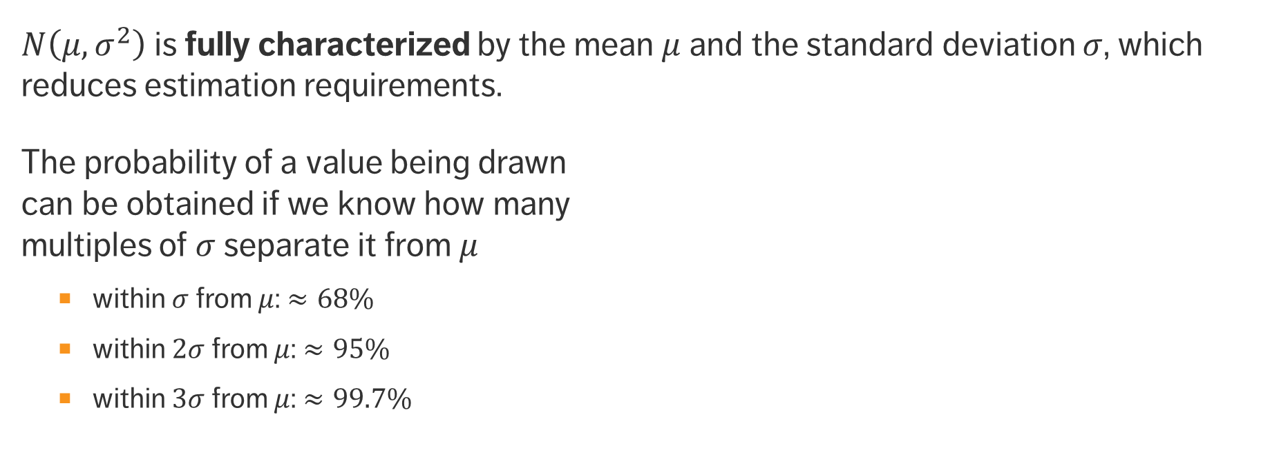
Normal Distribution
[image taken from Wikipedia]
$N\left(μ,σ^{2}\right)$is fully characterized by the mean $μ$and the standard deviation $σ$, which reduces estimation requirements.
The probability of a value being drawn can be obtained if we know how many multiples of $σ$ separate it from $μ$
within $σ$ from $μ$: $≈68\%$
within $2σ$ from $μ$: $≈95\%$
within $3σ$ from $μ$: $≈99.7\%$

Slide 27
Normal Distribution
The normal distribution is best suited for data meeting the following minimum requirements:
strong tendency for the data to take on a central value
positive, negative deviations from this central value are equally likely
frequency of the deviations falls off rapidly as we move further away from the central value.
Symmetry of deviations leads to zero skewness; low prob. of large deviations from the central value leads to no kurtosis.
Its omnipresence in human affairs is linked to the Central Limit Theorem.

Slide 28
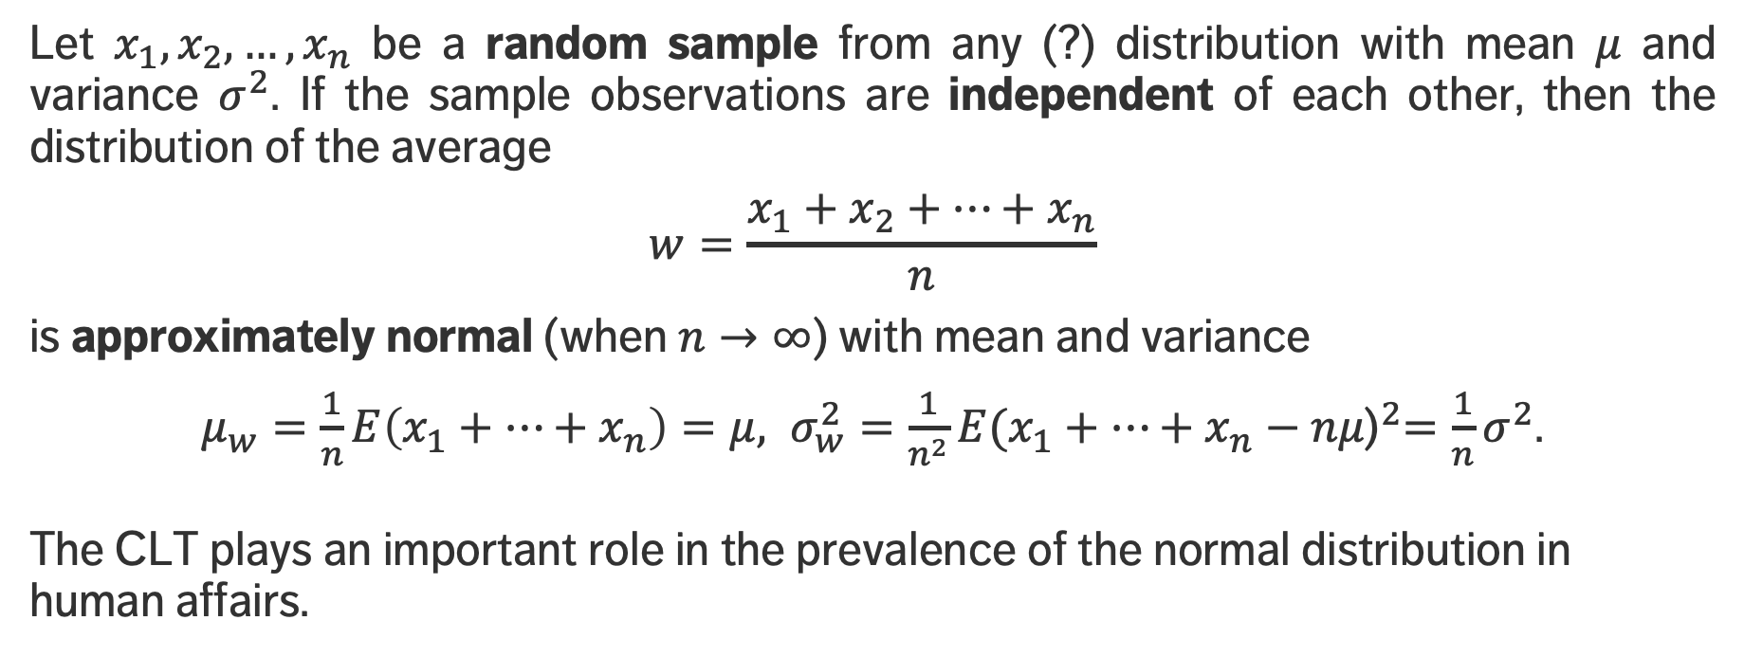
Central Limit Theorem
Let $x_{1},x_{2},…,x_{n}$ be a random sample from any (?) distribution with mean $μ$ and variance $σ^{2}$. If the sample observations are independent of each other, then the distribution of the average
$$w=\frac{x_{1}+x_{2}+…+x_{n}}{n}$$
is approximately normal (when $n→∞$) with mean and variance
$μ_{w}=\frac{1}{n}E\left(x_{1}+…+x_{n}\right)=μ, σ_{w}^{2}=\frac{1}{n^{2}}E{(x_{1}+…+x_{n}−nμ\text{)}}^{2}={\frac{1}{n}σ}^{2}$.
The CLT plays an important role in the prevalence of the normal distribution in human affairs.

Slide 29
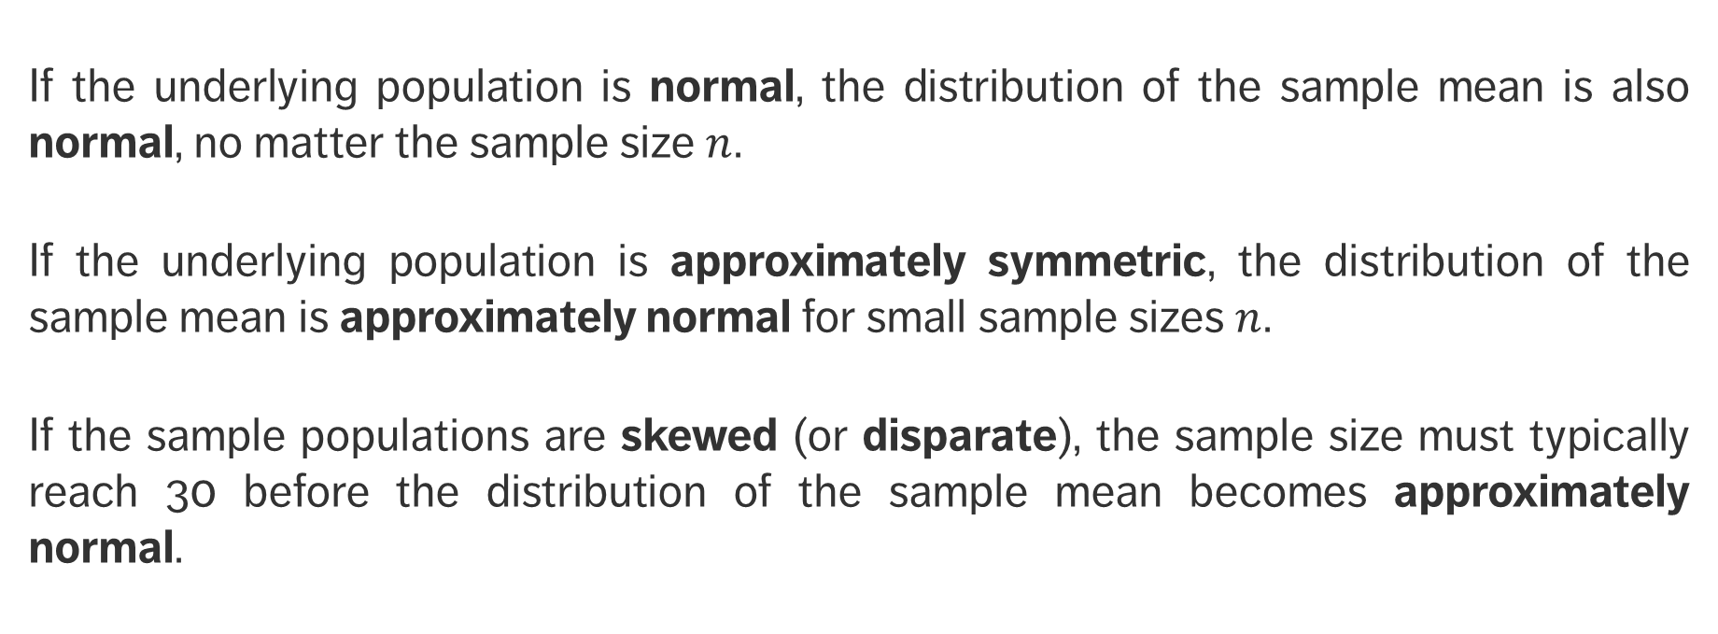
How Large is Large?
If the underlying population is normal, the distribution of the sample mean is also normal, no matter the sample size $n$.
If the underlying population is approximately symmetric, the distribution of the sample mean is approximately normal for small sample sizes $n$.
If the sample populations are skewed (or disparate), the sample size must typically reach 30 before the distribution of the sample mean becomes approximately normal.

Slide 30
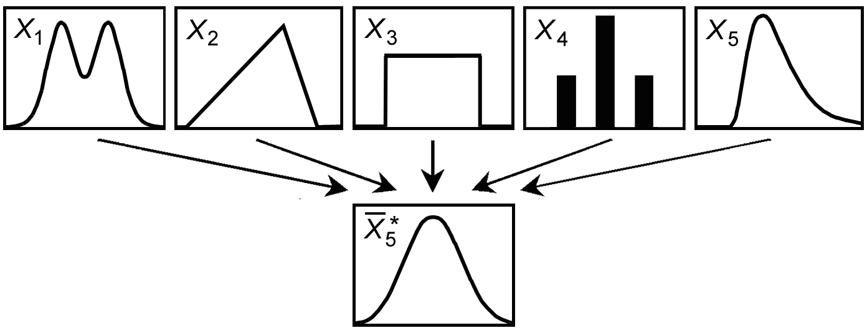
CENTRAL LIMIT THEOREM IN ACTION
[https://www.value-at-risk.net/central-limit-theorem]

Slide 31
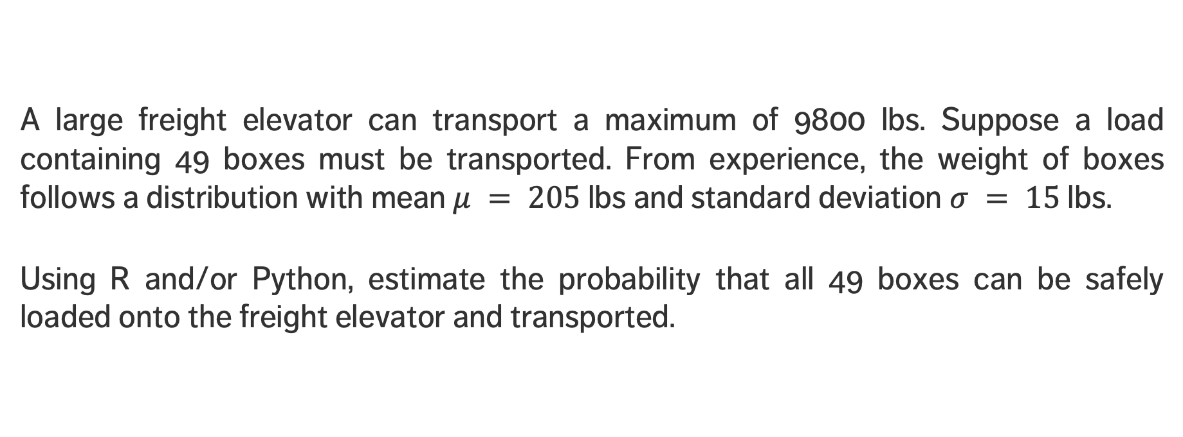
EXERCISES
A large freight elevator can transport a maximum of 9800 lbs. Suppose a load containing 49 boxes must be transported. From experience, the weight of boxes follows a distribution with mean $μ = 205$lbs and standard deviation $σ = 15$lbs.
Using R and/or Python, estimate the probability that all 49 boxes can be safely loaded onto the freight elevator and transported.

Slide 32
ESTIMATION
STATISTICAL AND MATHEMATICAL FOUNDATIONS

Slide 33
LEARNING OBJECTIVES
What is estimation, in a statistical sense?
What is estimation used for?
What is bias, in a statistical sense?

Slide 34
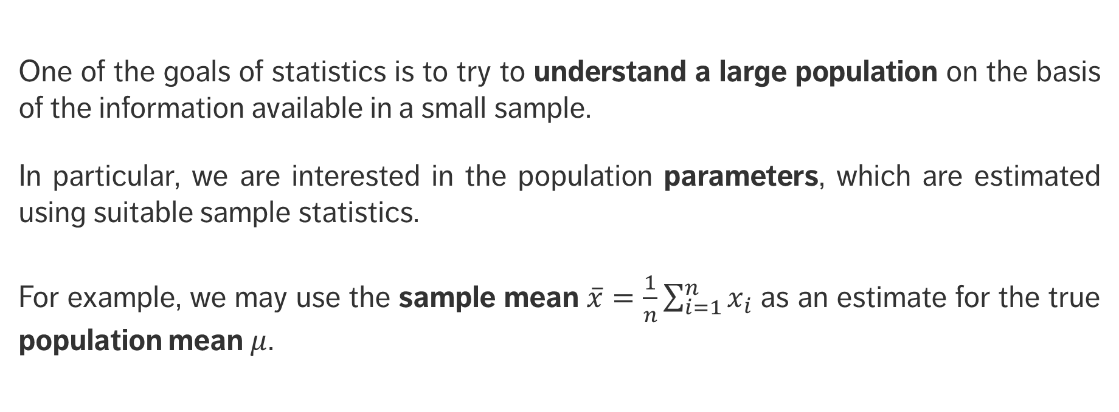
Estimation
One of the goals of statistics is to try to understand a large population on the basis of the information available in a small sample.
In particular, we are interested in the population parameters, which are estimated using suitable sample statistics.
For example, we may use the sample mean $\overline{x}=\frac{1}{n}\sum_{i=1}^{n}{x_{i}}$ as an estimate for the true population mean $μ$.

Slide 35
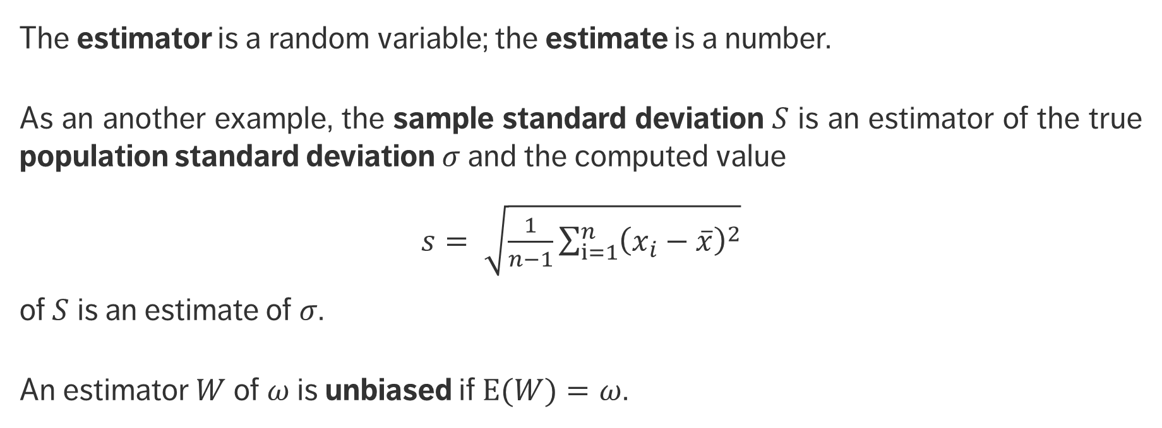
Estimation
The estimator is a random variable; the estimate is a number.
As an another example, the sample standard deviation $S$ is an estimator of the true population standard deviation $σ$ and the computed value
$s= \sqrt{\frac{1}{n−1}\sum_{i=1}^{n}{{\left(x_{i}−\overline{x}\right)}^{2}}}$
of $S$ is an estimate of $σ$.
An estimator $W$ of $ω$ is unbiased if $E(W)=ω$.

Slide 36
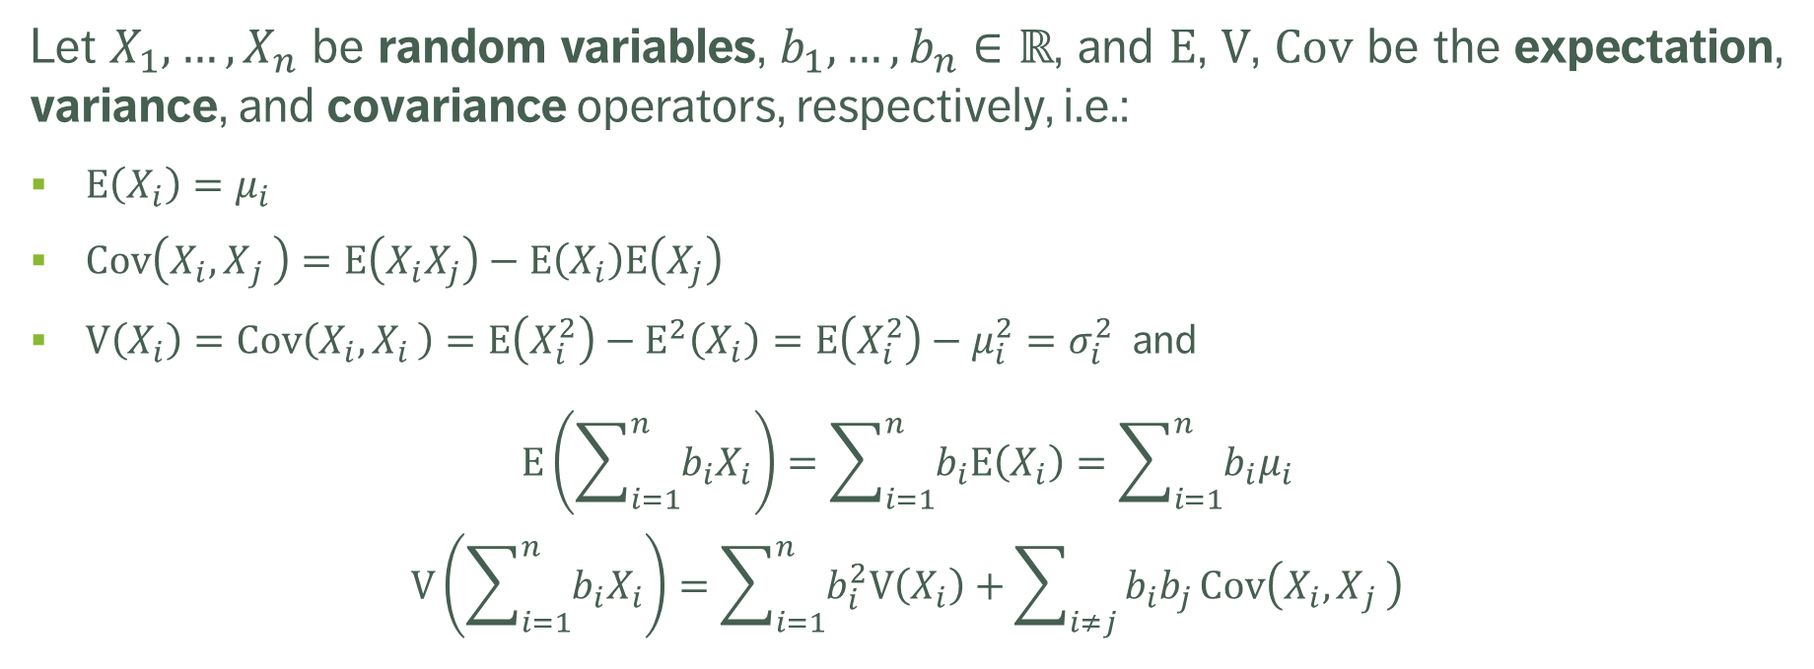
BASIC MATHEMATICAL CONCEPTS
Let $X_{1},…,X_{n}$ be random variables, $b_{1},…,b_{n}∈ℝ$, and $\text{E}$, $\text{V}$, $\text{Cov}$ be the expectation, variance, and covariance operators, respectively, i.e.:
$\text{E}\left(X_{i}\right)=μ_{i}$
$\text{Cov}\left(X_{i}{,X}_{j}\right)=\text{E}\left(X_{i}X_{j}\right)−\text{E}\left(X_{i}\right)\text{E}\left(X_{j}\right)$
$\text{V}\left(X_{i}\right)=\text{Cov}\left(X_{i}{,X}_{i}\right)=\text{E}\left(X_{i}^{2}\right)−{\text{E}}^{2}\left(X_{i}\right)=\text{E}\left(X_{i}^{2}\right)−μ_{i}^{2}=σ_{i}^{2}$ and
$$\text{E}\left(\sum_{i=1}^{n}{b_{i}X_{i}}\right)=\sum_{i=1}^{n}{b_{i}\text{E}\left(X_{i}\right)}=\sum_{i=1}^{n}{b_{i}μ_{i}}$$
$$\text{V}\left(\sum_{i=1}^{n}{b_{i}X_{i}}\right)=\sum_{i=1}^{n}{b_{i}^{2}\text{V}\left(X_{i}\right)}+\sum_{i≠j}{b_{i}b_{j}}\text{Cov}\left(X_{i}{,X}_{j}\right)$$

Slide 37
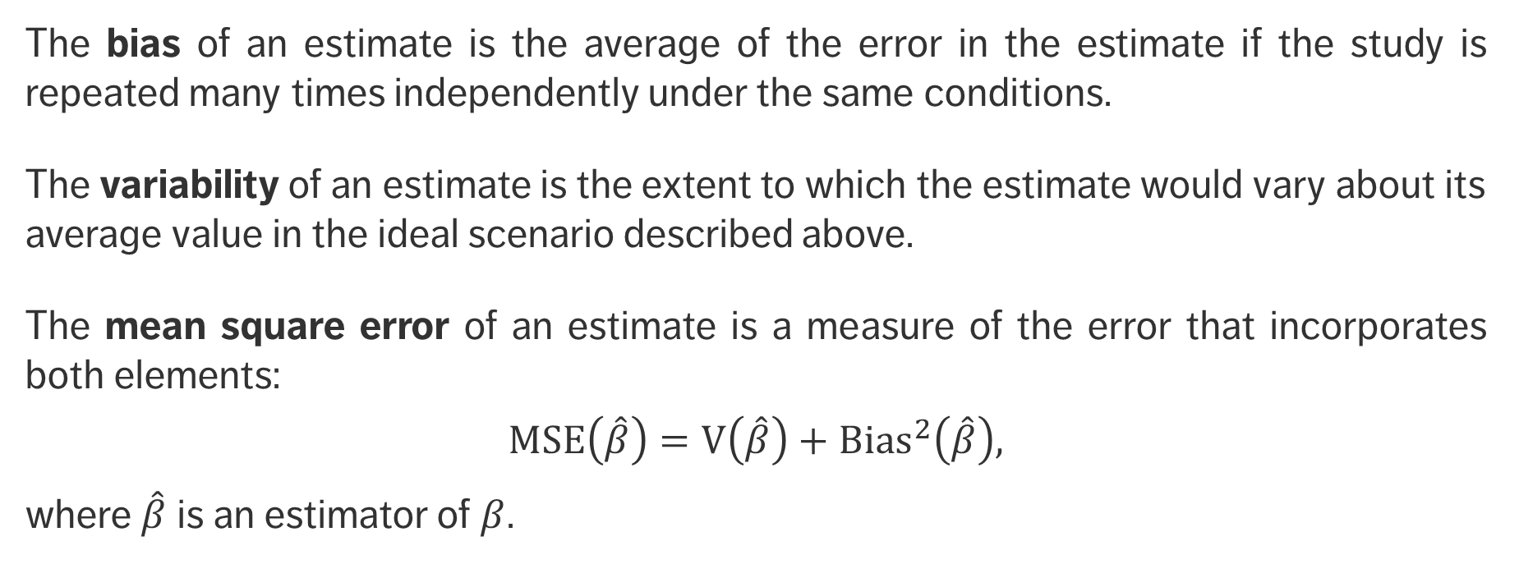
BASIC MATHEMATICAL CONCEPTS
The bias of an estimate is the average of the error in the estimate if the study is repeated many times independently under the same conditions.
The variability of an estimate is the extent to which the estimate would vary about its average value in the ideal scenario described above.
The mean square error of an estimate is a measure of the error that incorporates both elements:
$$MSE\left(\hat{β}\right)=\text{V}\left(\hat{β}\right)+{\text{Bias}}^{2}\left(\hat{β}\right),$$
where $\hat{β}$ is an estimator of $β$.

Slide 38
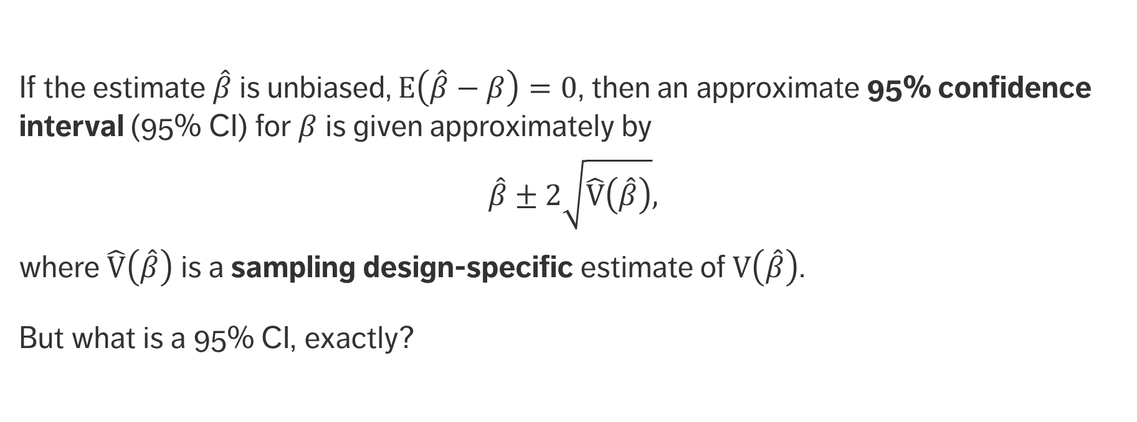
BASIC MATHEMATICAL CONCEPTS
If the estimate $\hat{β}$ is unbiased, $E\left(\hat{β}−β\right)=0$, then an approximate 95% confidence interval (95% CI) for $β$ is given approximately by
$$\hat{β}±2\sqrt{\hat{\text{V}}\left(\hat{β}\right)},$$
where $\hat{\text{V}}\left(\hat{β}\right)$ is a sampling design-specific estimate of $\text{V}\left(\hat{β}\right)$.
But what is a 95% CI, exactly?

Slide 39
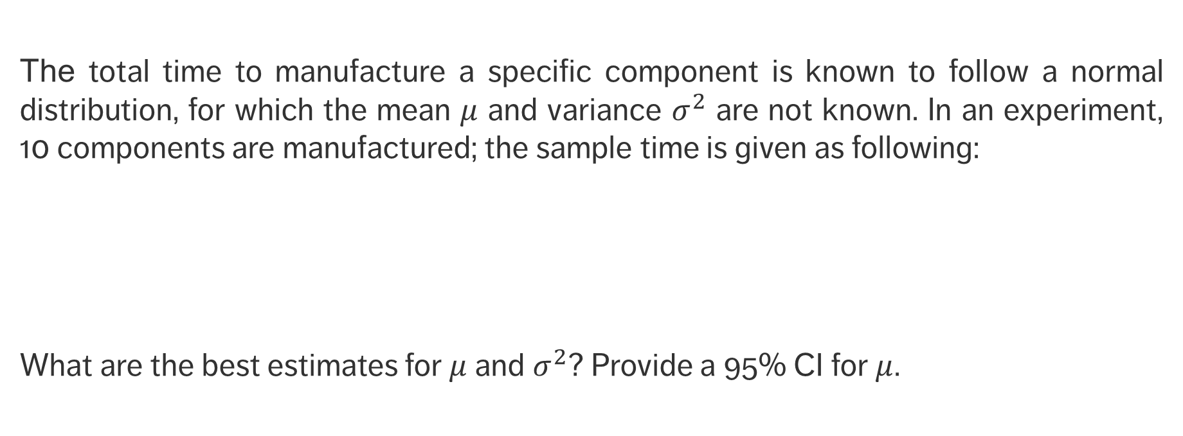
EXERCISE
The total time to manufacture a specific component is known to follow a normal distribution, for which the mean $μ$ and variance $σ^{2}$ are not known. In an experiment, 10 components are manufactured; the sample time is given as following:
What are the best estimates for $μ$ and $σ^{2}$? Provide a 95% CI for $μ$.
Time
1 | 2 | 3 | 4 | 5 | 6 | 7 | 8 | 9 | 10
63.8 | 60.5 | 65.3 | 65.7 | 61.9 | 68.2 | 68.1 | 64.8 | 65.8 | 65.4

Slide 40
BAYES’ THEOREM
STATISTICAL AND MATHEMATICAL FOUNDATIONS

Slide 41
LEARNING OBJECTIVES
What is a conditional probability and when is it useful?
What are some mathematical rules that govern probability?
What is Bayes’ Theorem and when is it useful?

Slide 42
Conditional Probabilities
We are often interested in the likelihood of an event occurring given that another has occurred.
Examples include:
the probability that a train arrives on time given that it left on time
the probability that a PC crashes given the operating system installed
the probability that a bit is transmitted over a channel is received as a 1 given that the bit transmitted was a 1
the probability that a website is visited given its number of in-links
Questions of this type are handled using conditional probability.

Slide 43
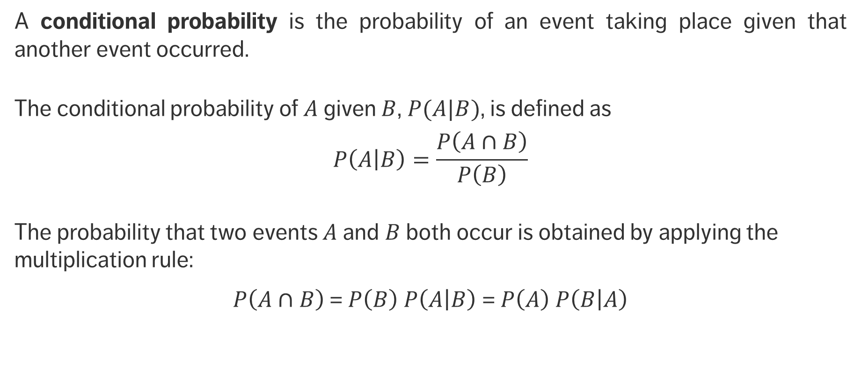
Conditional Probabilities
A conditional probability is the probability of an event taking place given that another event occurred.
The conditional probability of $A$ given $B$, $P(A|B)$, is defined as
$$P\left(\left.A\right|B\right)=\frac{P\left(A∩B\right)}{P\left(B\right)}$$
The probability that two events $A$ and $B$ both occur is obtained by applying the multiplication rule:
$P\left(A∩B\right)$= $P\left(B\right) P\left(\left.A\right|B\right)$ = $P\left(A\right) P\left(\left.B\right|A\right)$

Slide 44
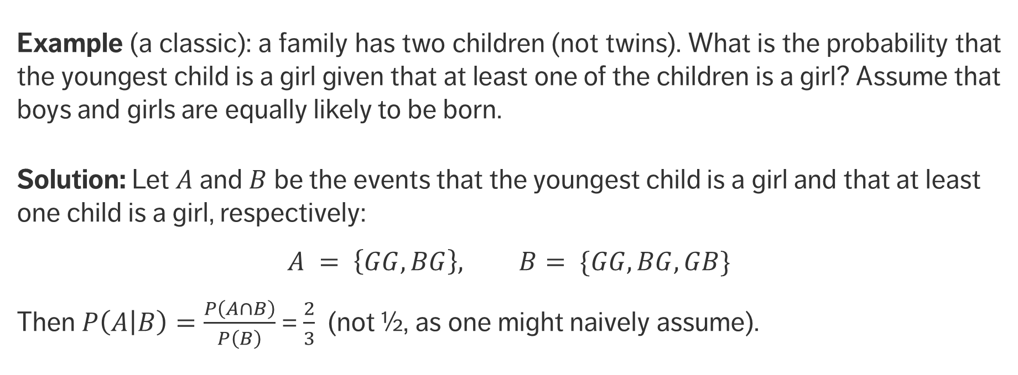
Conditional Probabilities
Example (a classic): a family has two children (not twins). What is the probability that the youngest child is a girl given that at least one of the children is a girl? Assume that boys and girls are equally likely to be born.
Solution: Let $A$ and $B$ be the events that the youngest child is a girl and that at least one child is a girl, respectively:
$$A = \left\{GG, BG\right\}, B= \{GG, BG, GB\}$$
Then $P\left(\left.A\right|B\right)=\frac{P\left(A∩B\right)}{P\left(B\right)}$ = $\frac{2}{3}$ (not ½, as one might naively assume).

Slide 45
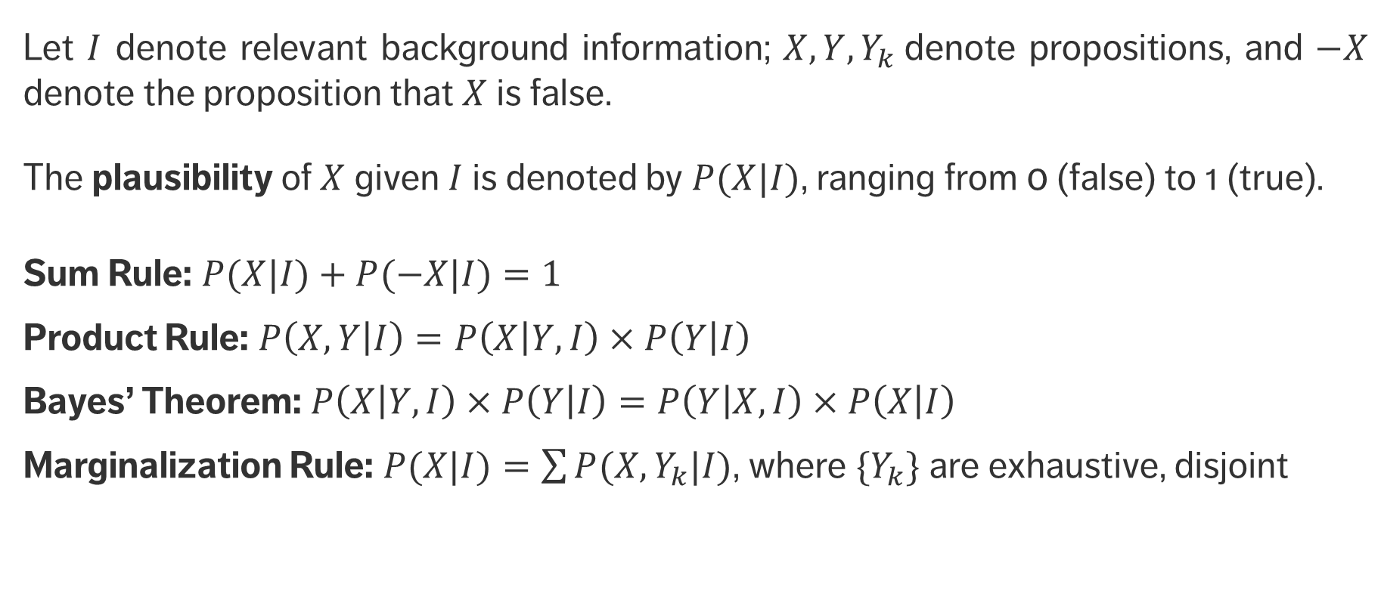
Rules of Probability
Let $I$ denote relevant background information; $X, Y, Y_{k}$denote propositions, and $−X$ denote the proposition that $X$ is false.
The plausibility of $X$ given $I$ is denoted by $P(X|I)$, ranging from 0 (false) to 1 (true).
Sum Rule: $P(X|I)+P(−X|I)=1$
Product Rule: $P\left(X,Y | I\right)=P\left(X | Y,I\right)×P\left(Y | I\right)$
Bayes’ Theorem: $P\left(X | Y,I\right)×P\left(Y | I\right)=P\left(Y | X,I\right)×P\left(X | I\right)$
Marginalization Rule: $P(X|I)=\sum{P(X,Y_{k}|I)}$, where ${\{Y}_{k}\}$ are exhaustive, disjoint

Slide 46
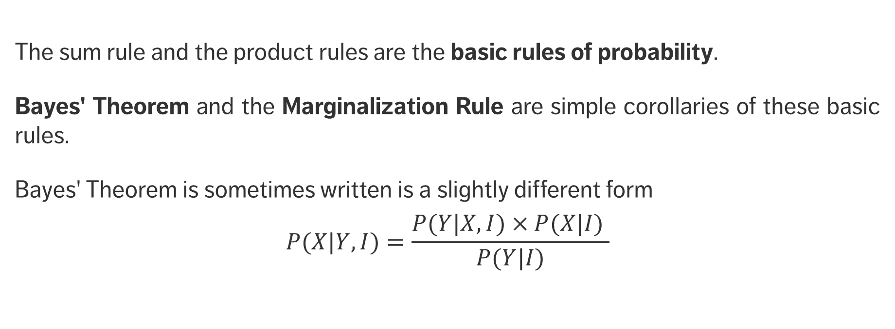
Bayes’ Theorem
The sum rule and the product rules are the basic rules of probability.
Bayes' Theorem and the Marginalization Rule are simple corollaries of these basic rules.
Bayes' Theorem is sometimes written is a slightly different form
$$P(X|Y,I)=\frac{P(Y|X,I)×P(X|I) }{P(Y|I)}$$

Slide 47
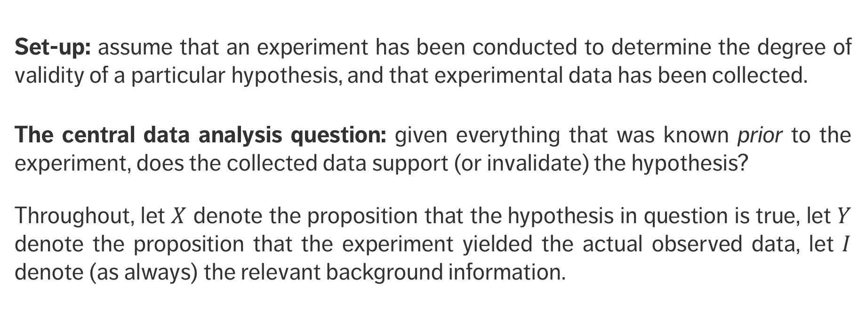
Bayes’ Theorem
Set-up: assume that an experiment has been conducted to determine the degree of validity of a particular hypothesis, and that experimental data has been collected.
The central data analysis question: given everything that was known prior to the experiment, does the collected data support (or invalidate) the hypothesis?
Throughout, let $X$ denote the proposition that the hypothesis in question is true, let $Y$ denote the proposition that the experiment yielded the actual observed data, let $I$ denote (as always) the relevant background information.

Slide 48
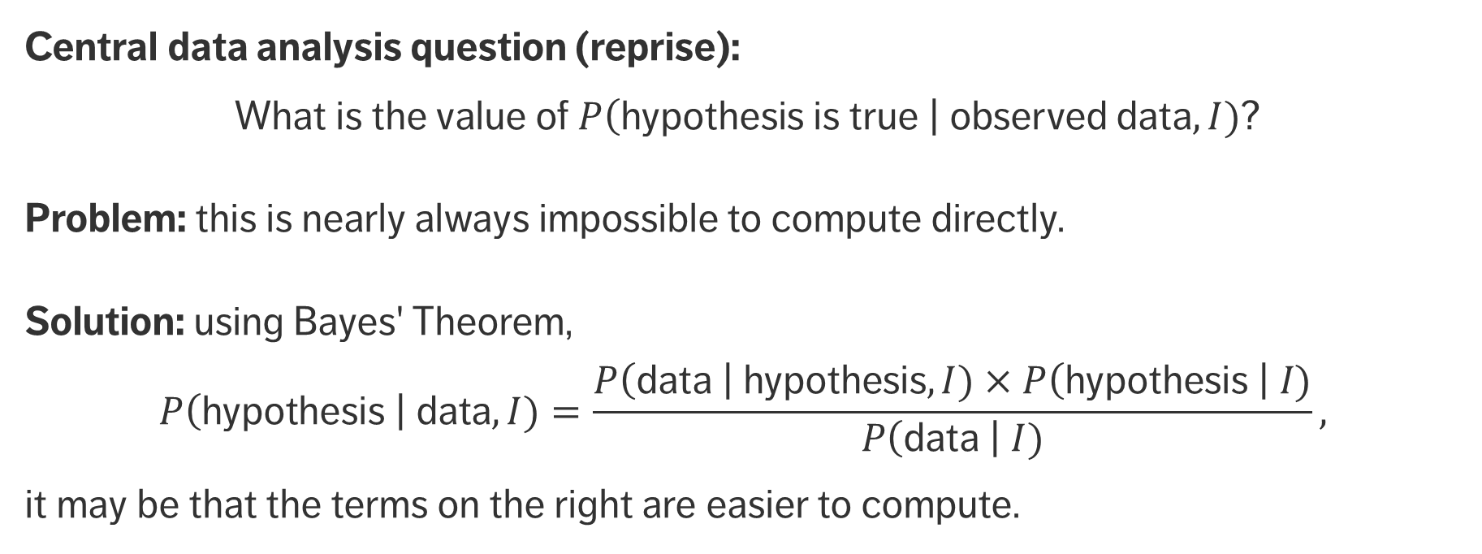
Bayes’ Theorem
Central data analysis question (reprise):
What is the value of $P\left(\text{hypothesis} \text{is} \text{true} \right| \text{observed} \text{data},I)$?
Problem: this is nearly always impossible to compute directly.
Solution: using Bayes' Theorem,
$$P\left(\text{hypothesis} \right| \text{data},I)=\frac{P\left(\text{data} \right| \text{hypothesis},I)×P\left(\text{hypothesis} \right| I)}{P\left(\text{data} \right| I)},$$
it may be that the terms on the right are easier to compute.

Slide 49
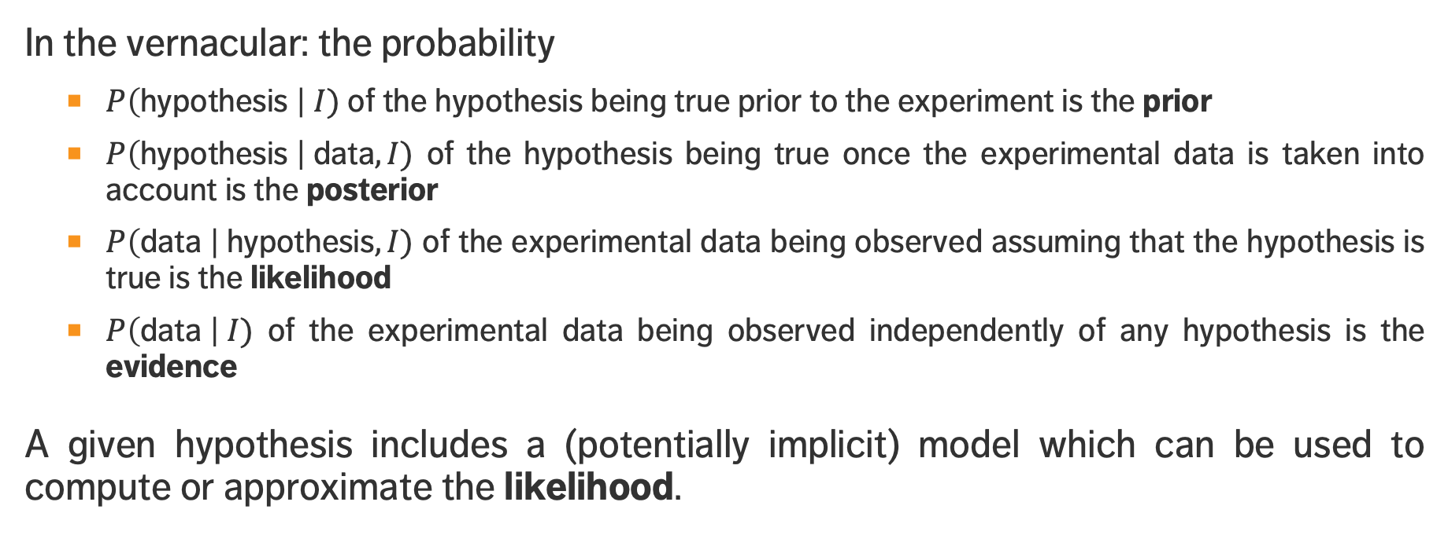
Bayes’ Theorem
In the vernacular: the probability
$P\left(\text{hypothesis} \right| I)$ of the hypothesis being true prior to the experiment is the prior
$P\left(\text{hypothesis} \right| \text{data},I)$ of the hypothesis being true once the experimental data is taken into account is the posterior
$P\left(\text{data} \right| \text{hypothesis},I)$ of the experimental data being observed assuming that the hypothesis is true is the likelihood
$P\left(\text{data} \right| I)$ of the experimental data being observed independently of any hypothesis is the evidence
A given hypothesis includes a (potentially implicit) model which can be used to compute or approximate the likelihood.

Slide 50
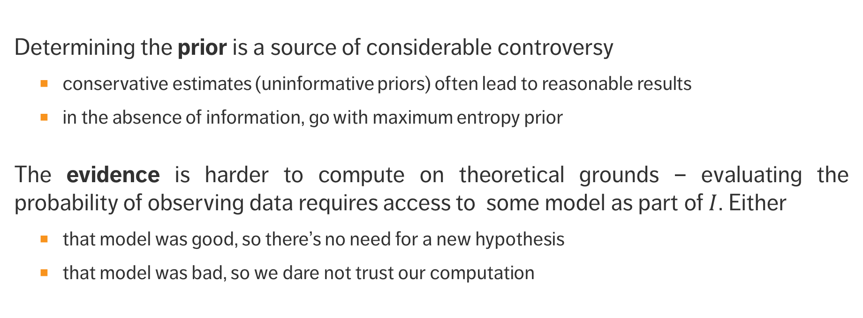
Bayes’ Theorem
Determining the prior is a source of considerable controversy
conservative estimates (uninformative priors) often lead to reasonable results
in the absence of information, go with maximum entropy prior
The evidence is harder to compute on theoretical grounds – evaluating the probability of observing data requires access to some model as part of $I$. Either
that model was good, so there’s no need for a new hypothesis
that model was bad, so we dare not trust our computation

Slide 51
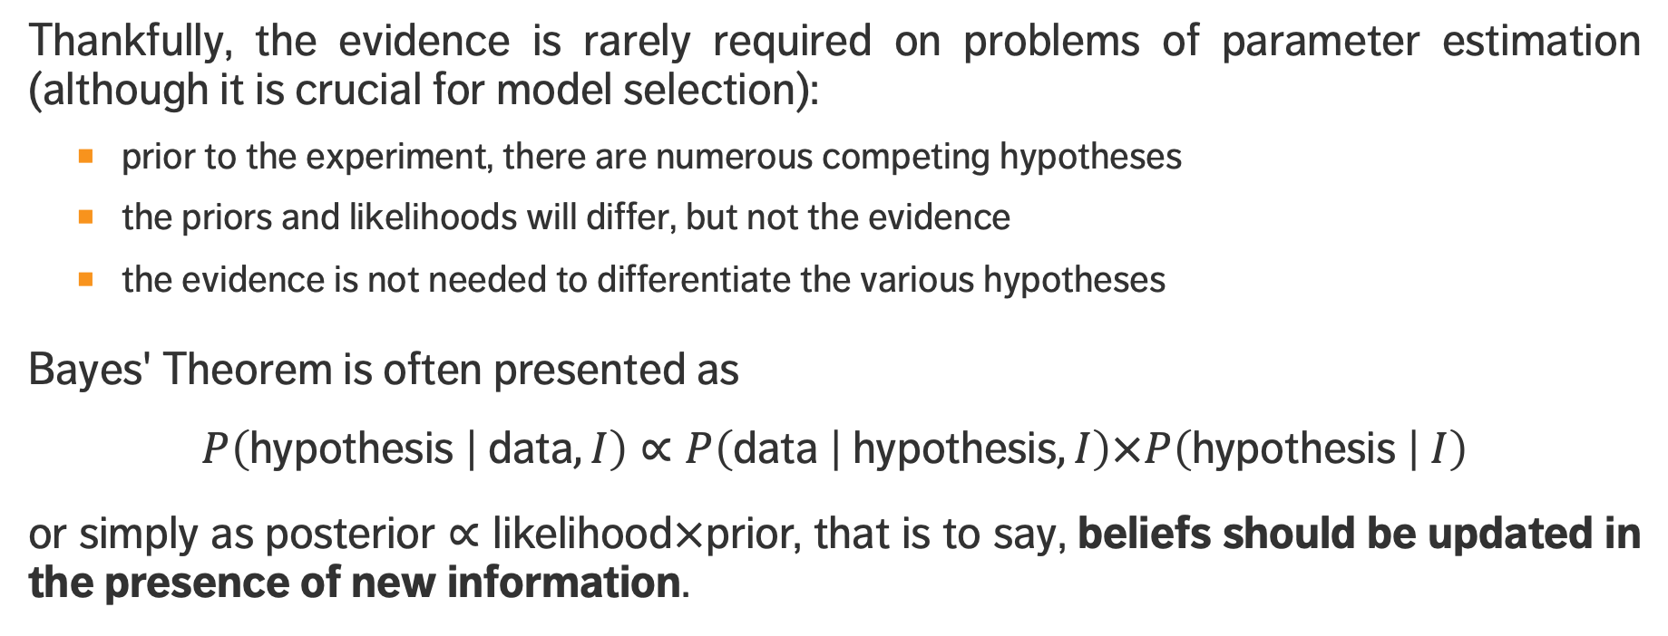
Bayes’ Theorem
Thankfully, the evidence is rarely required on problems of parameter estimation (although it is crucial for model selection):
prior to the experiment, there are numerous competing hypotheses
the priors and likelihoods will differ, but not the evidence
the evidence is not needed to differentiate the various hypotheses
Bayes' Theorem is often presented as
$$P\left(\text{hypothesis} | \text{data},I\right)∝P\left(\text{data} | \text{hypothesis},I\right)×P\left(\text{hypothesis} | I\right)$$
or simply as $\text{posterior}∝\text{likelihood}×\text{prior}\text{,}$ that is to say, beliefs should be updated in the presence of new information.

Slide 52
EXERCISE
Suppose that a test for a particular disease has a very high success rate. If a patient
has the disease, the test accurately reports a ’positive’ with probability 0.99;
does not have the disease, the test accurately reports a ’negative’ with probability 0.95.
Assume further that only 0.1% of the population has the disease. What is the probability that a patient who tests positive does not in fact have the disease?

Slide 53
MATRIX ALGEBRA
STATISTICAL AND MATHEMATICAL FOUNDATIONS
Neo: What is the Matrix? Trinity: The answer is out there, Neo. It's looking for you, and it will find you if you want it to.
(The Matrix, the Wachowski Sisters)

Slide 54
LEARNING OBJECTIVES
What is the main mathematical object involved in linear algebra?
Why are matrices relevant in data science/data analysis?
What are some matrix operations?

Slide 55
Linear Algebra
A matrix is an important mathematical tool that allows for easy organization of information, simplifies notation, and facilitates the application of algorithms to data.
Most statistical tools require rectangular data:
each column contains a variable (feature, field, attribute)
- indicator, target, question in a survey, etc.
each row contains an observation (case, unit, item)
- country, survey respondent, subject in an experiment, etc.
each cell contains a value (measurement) for a particular variable and observation
- GDP per capita for Canada, answer to a specific question, age, etc.

Slide 56
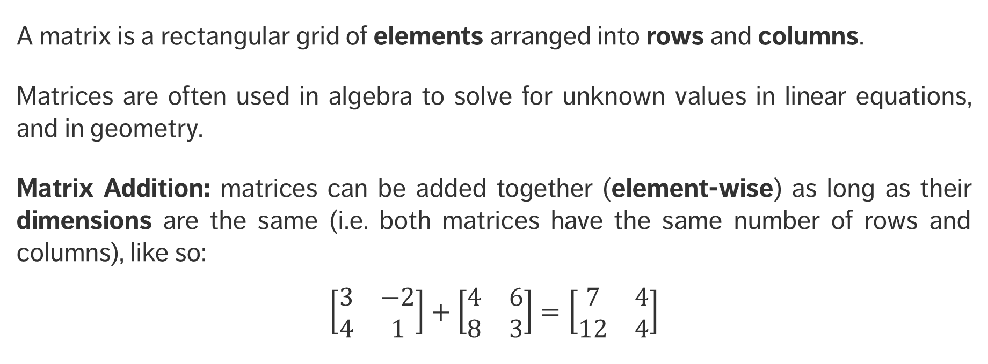
Matrix Operations
A matrix is a rectangular grid of elements arranged into rows and columns.
Matrices are often used in algebra to solve for unknown values in linear equations, and in geometry.
Matrix Addition: matrices can be added together (element-wise) as long as their dimensions are the same (i.e. both matrices have the same number of rows and columns), like so:
$$\left[\begin{matrix}3 & −2 \\ 4 & 1\end{matrix}\right]+\left[\begin{matrix}4 & 6 \\ 8 & 3\end{matrix}\right]=\left[\begin{matrix}7 & 4 \\ 12 & 4\end{matrix}\right]$$

Slide 57
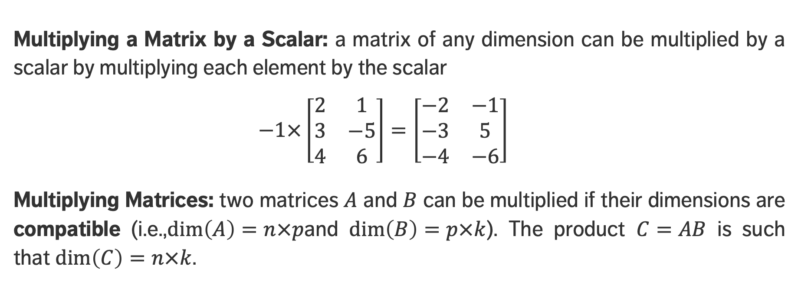
Matrix Operations
Multiplying a Matrix by a Scalar: a matrix of any dimension can be multiplied by a scalar by multiplying each element by the scalar
$$−1×\left[\begin{matrix}2 & 1 \\ 3 & −5 \\ 4 & 6\end{matrix}\right]=\left[\begin{matrix}−2 & −1 \\ −3 & 5 \\ −4 & −6\end{matrix}\right]$$
Multiplying Matrices: two matrices $A$ and $B$ can be multiplied if their dimensions are compatible (i.e.,$dim\left(A\right)=n×p$and $dim\left(B\right)=p×k$). The product $C=AB$ is such that $dim\left(C\right)=n×k$.

Slide 58
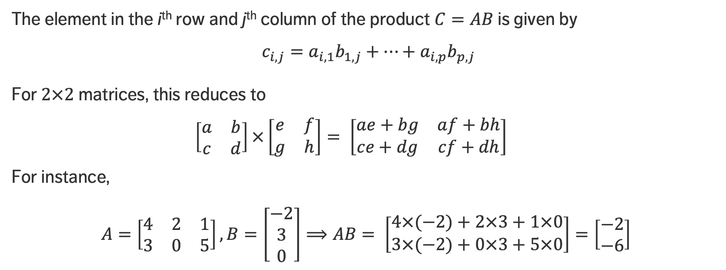
Matrix Operations
The element in the i^{th} row and j^{th} column of the product $C=AB$is given by
$c_{i,j}=a_{i,1}b_{1,j}+⋯+$ $a_{i,p}b_{p,j}$
For $2×2$ matrices, this reduces to
$$\left[\begin{matrix}a & b \\ c & d\end{matrix}\right]×\left[\begin{matrix}e & f \\ g & h\end{matrix}\right]= \left[\begin{matrix}ae+bg & af+bh \\ ce+dg & cf+dh\end{matrix}\right]$$
For instance,
$A=\left[\begin{matrix}4 & 2 & 1 \\ 3 & 0 & 5\end{matrix}\right], B=\left[\begin{matrix}−2 \\ 3 \\ 0\end{matrix}\right]⟹AB= \left[\begin{matrix}4×(−2)+2×3+1×0 \\ 3×(−2)+0×3+5×0\end{matrix}\right]=\left[\begin{matrix}−2 \\ −6\end{matrix}\right]$

Slide 59
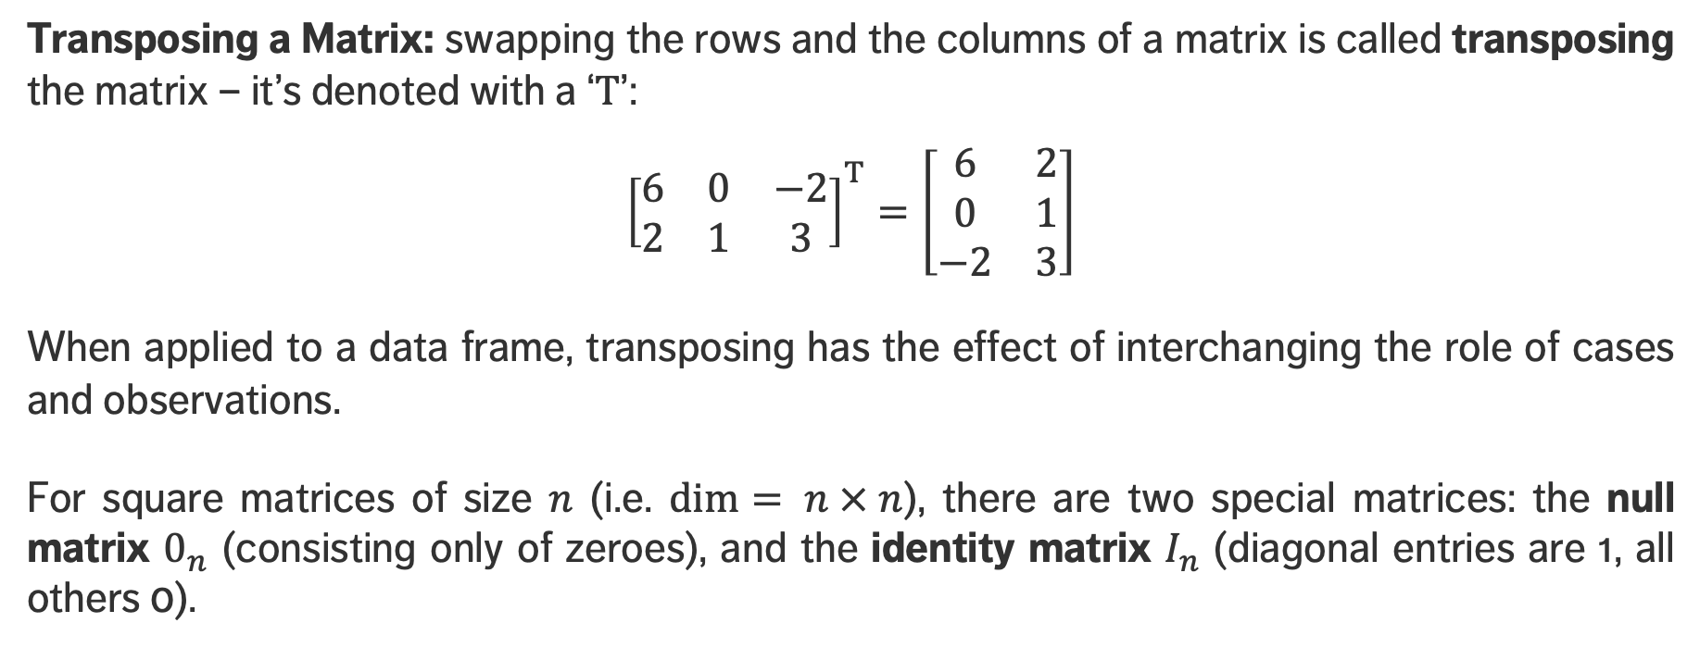
Matrix Operations
Transposing a Matrix: swapping the rows and the columns of a matrix is called transposing the matrix – it’s denoted with a ‘$T$’:
$${\left[\begin{matrix}6 & 0 & −2 \\ 2 & 1 & 3\end{matrix}\right]}^{T}=\left[\begin{matrix}6 & 2 \\ 0 & 1 \\ −2 & 3\end{matrix}\right]$$
When applied to a data frame, transposing has the effect of interchanging the role of cases and observations.
For square matrices of size $n$ (i.e. $dim⁡= n × n$), there are two special matrices: the null matrix $0_{n}$ (consisting only of zeroes), and the identity matrix $I_{n}$ (diagonal entries are 1, all others 0).

Slide 60
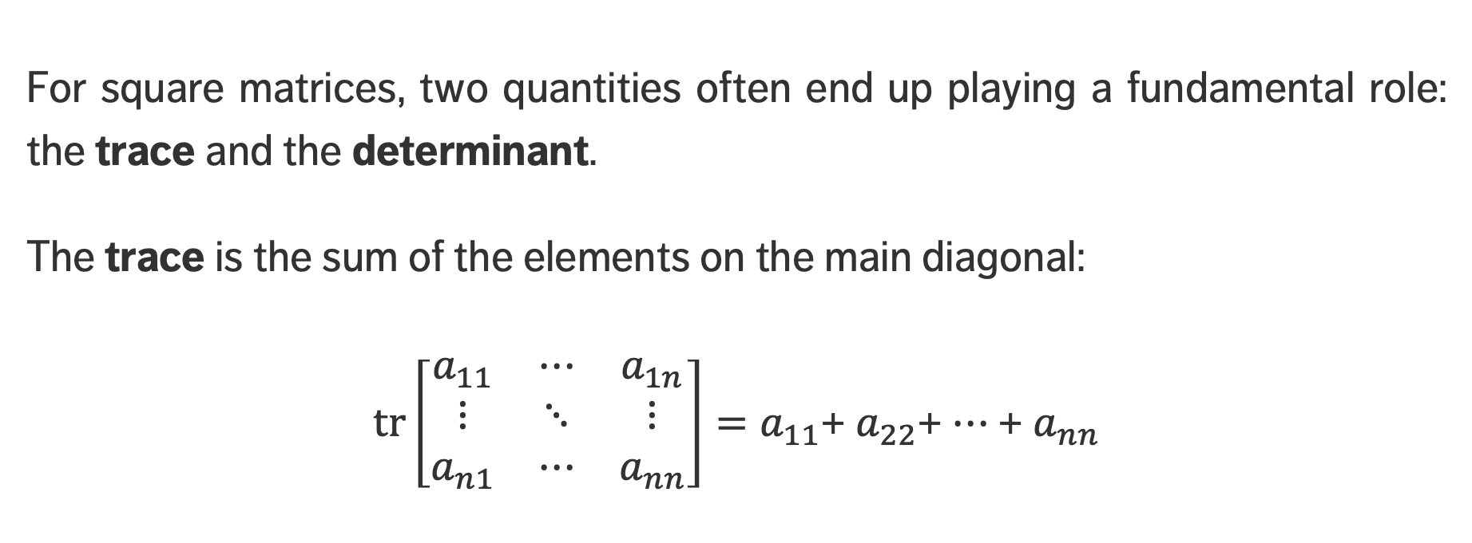
Matrix Operations
For square matrices, two quantities often end up playing a fundamental role: the trace and the determinant.
The trace is the sum of the elements on the main diagonal:
$\text{t}\text{r}\left[\begin{matrix}a_{11} & ⋯ & a_{1n} \\ ⋮ & ⋱ & ⋮ \\ a_{n1} & ⋯ & a_{nn}\end{matrix}\right]=a_{11}$+ $a_{22}$+ $⋯$ + $a_{nn}$

Slide 61
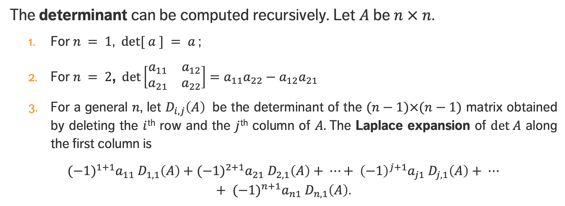
Matrix Operations
The determinant can be computed recursively. Let $A$ be $n × n$.
For $n = 1$, $det⁡[ a ] = a$;
For $n = 2$, $det\left[\begin{matrix}a_{11} & a_{12} \\ a_{21} & a_{22}\end{matrix}\right]=a_{11}a_{22}−a_{12}a_{21}$
For a general $n$, let $D_{i,j}\left(A\right)$ be the determinant of the $(n−1)×(n−1)$ matrix obtained by deleting the $i$^{th} row and the $j$^{th} column of $A.$The Laplace expansion of $det A$ along the first column is
${{(−1)}^{1+1}a}_{11} D_{1,1}\left(A\right)+{{(−1)}^{2+1}a}_{21} D_{2,1}\left(A\right)+ ⋯+ {\left(−1\right)}^{j+1}a_{j1} D_{j,1}\left(A\right)+ ⋯+ {(−1)}^{n+1}a_{n1} D_{n,1}\left(A\right)$.

Slide 62
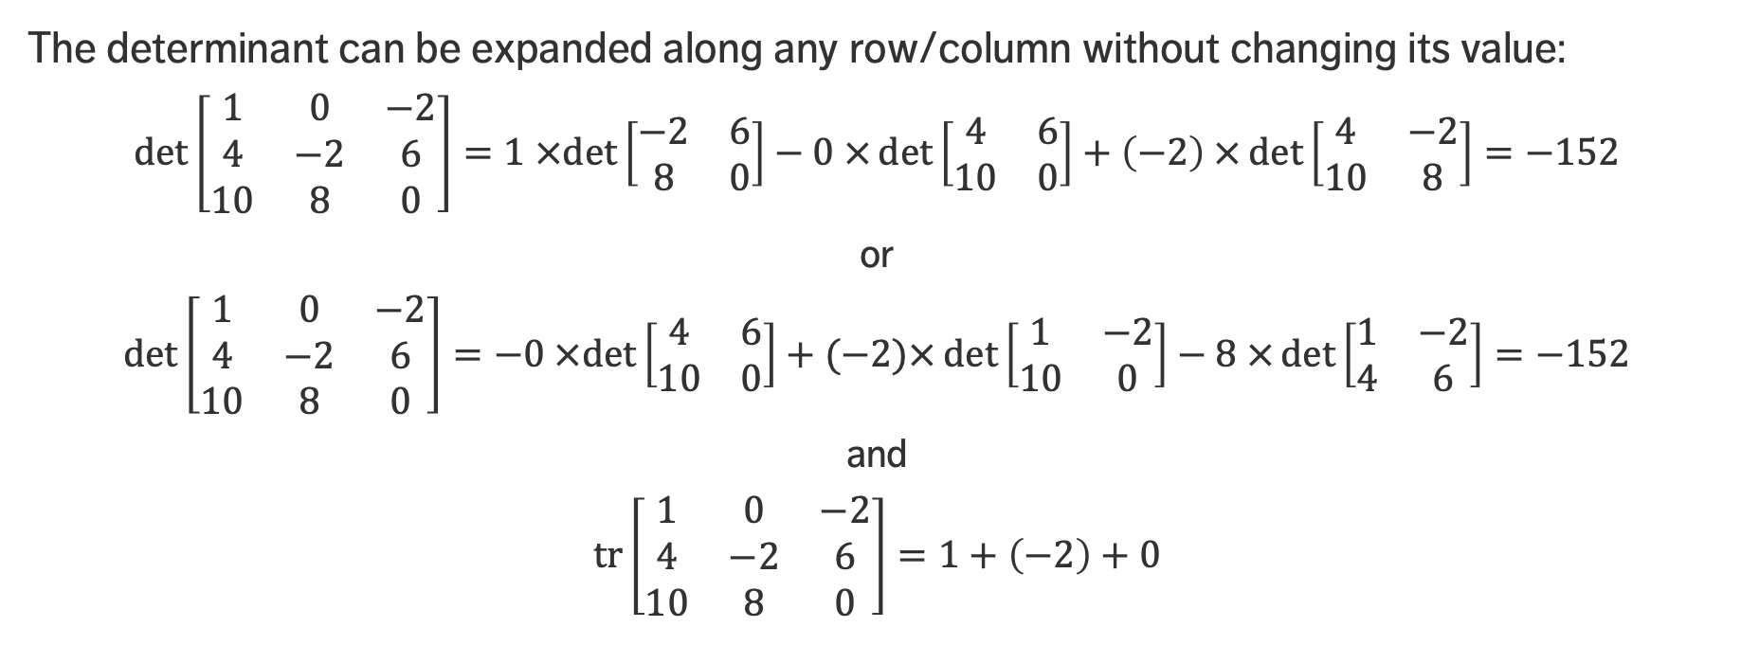
Matrix Operations
The determinant can be expanded along any row/column without changing its value:
$$\det\left[\begin{matrix}1 & 0 & −2 \\ 4 & −2 & 6 \\ 10 & 8 & 0\end{matrix}\right]=1 ×det\left[\begin{matrix}−2 & 6 \\ 8 & 0\end{matrix}\right]−0 ×\det\left[\begin{matrix}4 & 6 \\ 10 & 0\end{matrix}\right]+\left(−2\right) ×\det\left[\begin{matrix}4 & −2 \\ 10 & 8\end{matrix}\right]=−152$$
or
$$\det\left[\begin{matrix}1 & 0 & −2 \\ 4 & −2 & 6 \\ 10 & 8 & 0\end{matrix}\right]=−0 ×det\left[\begin{matrix}4 & 6 \\ 10 & 0\end{matrix}\right]+(−2)×\det\left[\begin{matrix}1 & −2 \\ 10 & 0\end{matrix}\right]−8 ×\det\left[\begin{matrix}1 & −2 \\ 4 & 6\end{matrix}\right]=−152$$
and
$$\operatorname{tr}\left[\begin{matrix}1 & 0 & −2 \\ 4 & −2 & 6 \\ 10 & 8 & 0\end{matrix}\right]=1+\left(−2\right)+0$$

Slide 63
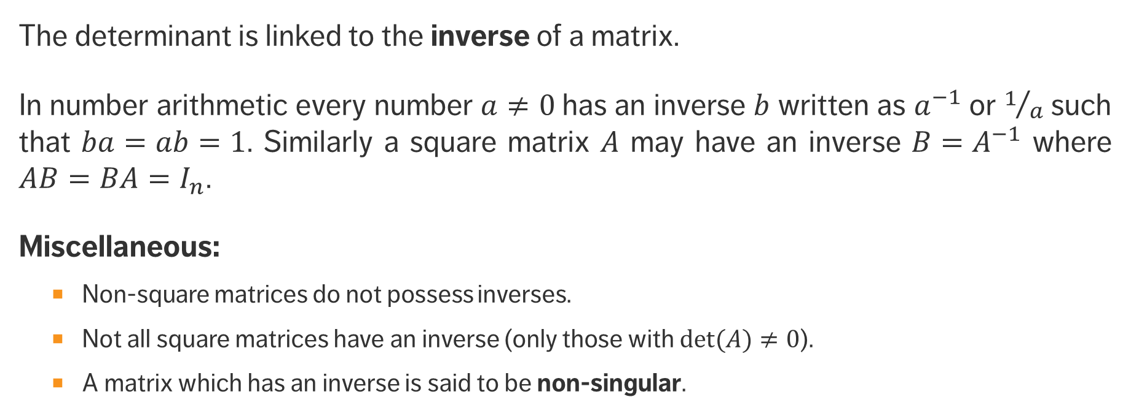
Matrix Operations
The determinant is linked to the inverse of a matrix.
In number arithmetic every number $a≠0$has an inverse $b$ written as $a^{−1}$or $1/a$ such that $ba=ab=1$. Similarly a square matrix $A$ may have an inverse $B=A^{−1}$ where $AB=BA=I_{n}$.
Miscellaneous:
Non-square matrices do not possess inverses.
Not all square matrices have an inverse (only those with $det⁡(A)≠0$).
A matrix which has an inverse is said to be non-singular.

Slide 64
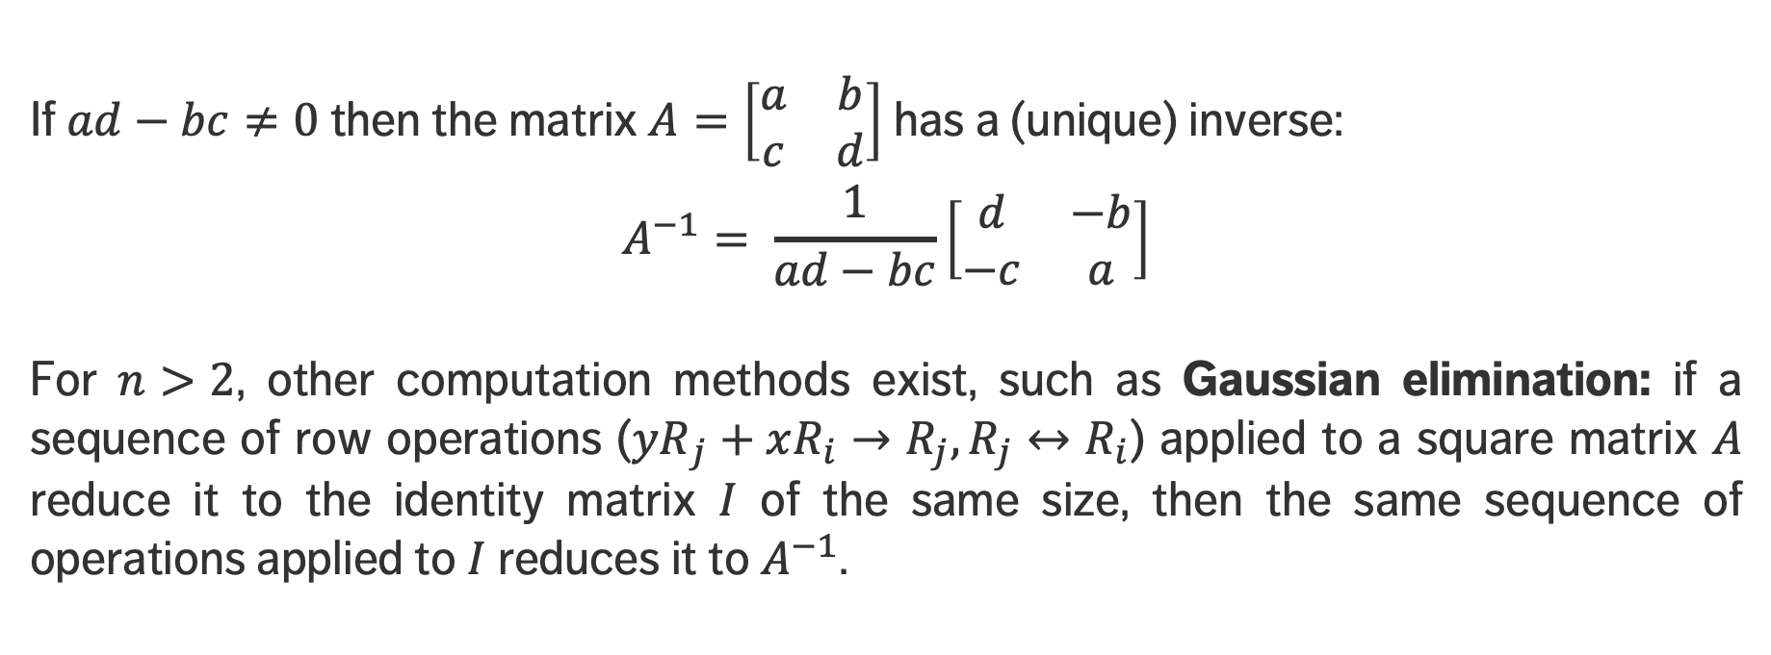
Matrix Operations
If $ad−bc≠0$ then the matrix $A=\left[\begin{matrix}a & b \\ c & d\end{matrix}\right]$has a (unique) inverse:
$$A^{−1}= \frac{1}{ad−bc}\left[\begin{matrix}d & −b \\ −c & a\end{matrix}\right]$$
For $n>2$, other computation methods exist, such as Gaussian elimination: if a sequence of row operations (${yR}_{j}+xR_{i}→R_{j},R_{j}↔R_{i}$) applied to a square matrix $A$ reduce it to the identity matrix $I$ of the same size, then the same sequence of operations applied to $I$reduces it to $A^{−1}$.

Slide 65
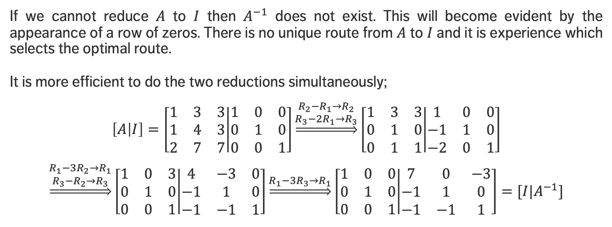
Matrix Operations
If we cannot reduce $A$ to $I$ then $A^{−1}$ does not exist. This will become evident by the appearance of a row of zeros. There is no unique route from $A$ to $I$ and it is experience which selects the optimal route.
It is more efficient to do the two reductions simultaneously;
$$\left[A | I\right]=\left[\begin{matrix}1 & 3 & 3 \\ 1 & 4 & 3 \\ 2 & 7 & 7\end{matrix} | \begin{matrix}1 & 0 & 0 \\ 0 & 1 & 0 \\ 0 & 0 & 1\end{matrix}\right]\underset{⇒}{\begin{aligned}R_{2}−R_{1}→R_{2} \\ R_{3}−{2R}_{1}→R_{3}\end{aligned}}\left[\begin{matrix}1 & 3 & 3 \\ 0 & 1 & 0 \\ 0 & 1 & 1\end{matrix} | \begin{matrix}1 & 0 & 0 \\ −1 & 1 & 0 \\ −2 & 0 & 1\end{matrix}\right]$$
$$\underset{⇒}{\begin{aligned}R_{1}−3R_{2}→R_{1} \\ R_{3}−R_{2}→R_{3}\end{aligned}}\left[\begin{matrix}1 & 0 & 3 \\ 0 & 1 & 0 \\ 0 & 0 & 1\end{matrix} | \begin{matrix}4 & −3 & 0 \\ −1 & 1 & 0 \\ −1 & −1 & 1\end{matrix}\right]\underset{⇒}{R_{1}−{3R}_{3}→R_{1}}\left[\begin{matrix}1 & 0 & 0 \\ 0 & 1 & 0 \\ 0 & 0 & 1\end{matrix} | \begin{matrix}7 & 0 & −3 \\ −1 & 1 & 0 \\ −1 & −1 & 1\end{matrix}\right]=[I{|A}^{−1}]$$

Slide 66
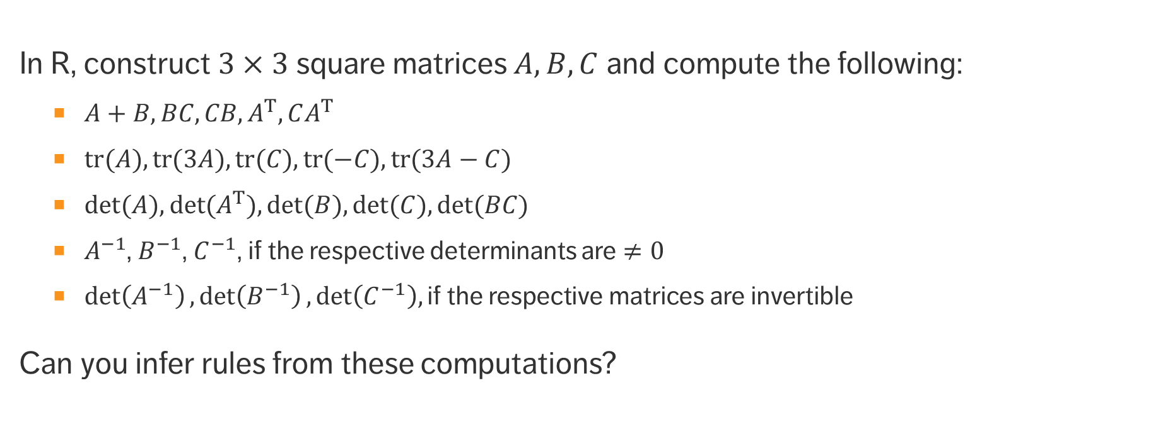
EXERCISES
In R, construct $3×3$ square matrices $A, B, C$ and compute the following:
$A+B, BC, CB, A^{T}, CA^{T}$
$tr(A), tr(3A), tr(C), tr(−C), tr(3A−C)$
$det⁡(A), det⁡(A^{T}), det⁡(B), det⁡(C), det⁡(BC)$
$A^{−1}$, $B^{−1}$, $C^{−1}$, if the respective determinants are $≠0$
$\det\left(A^{−1}\right),\det\left(B^{−1}\right),\det\left(C^{−1}\right),\text{if} \text{the} \text{respective} \text{matrices} \text{are} \text{invertible}$
Can you infer rules from these computations?

Slide 67
EIGENVALUES AND EIGENVECTORS
STATISTICAL AND MATHEMATICAL FOUNDATIONS

Slide 68
LEARNING OBJECTIVES
What is an eigenvalue?
What is an eigenvector?
What is a use case for these mathematical concepts?

Slide 69
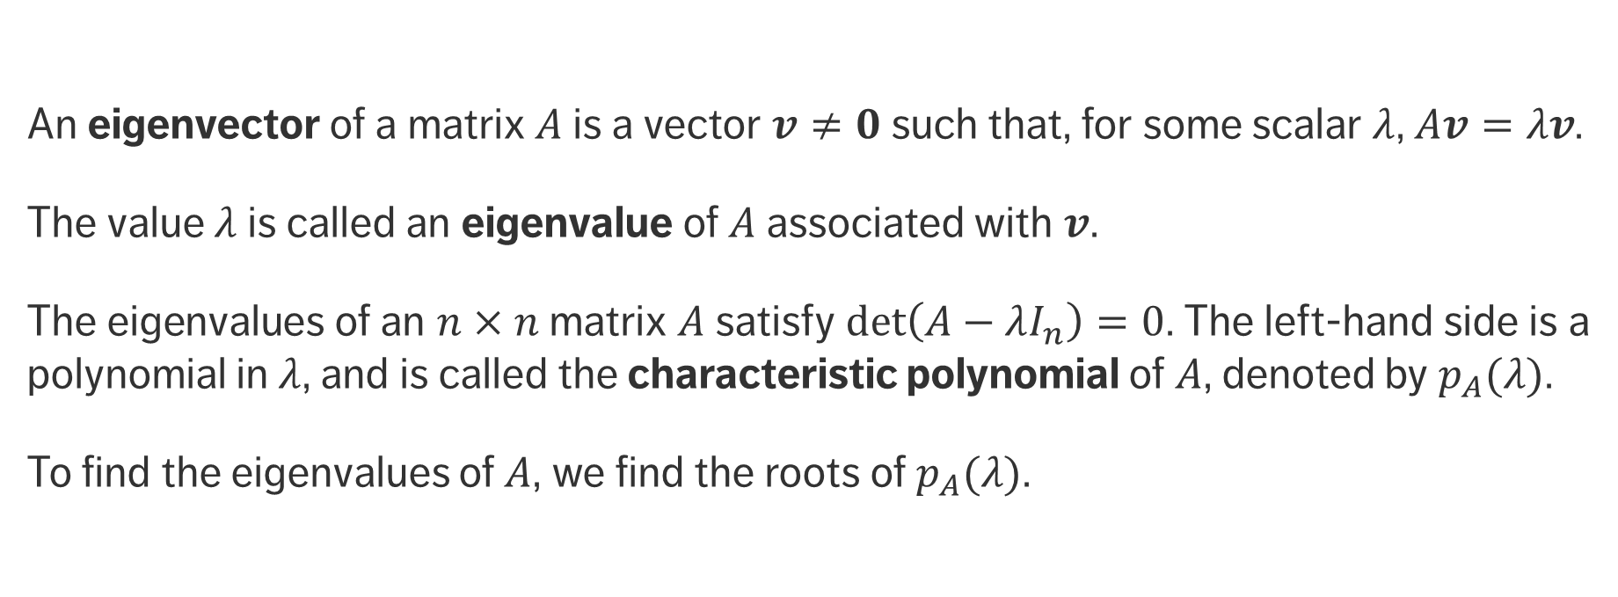
Eigenvectors and Eigenvalues
An eigenvector of a matrix $A$ is a vector $v≠0$ such that, for some scalar $λ$, $Av=λv$.
The value $λ$ is called an eigenvalue of $A$ associated with $v$.
The eigenvalues of an $n×n$ matrix $A$ satisfy $\det\left(A−λI_{n}\right)=0$. The left-hand side is a polynomial in $λ$, and is called the characteristic polynomial of $A$, denoted by $p_{A}(λ)$.
To find the eigenvalues of $A$, we find the roots of $p_{A}(λ)$.

Slide 70
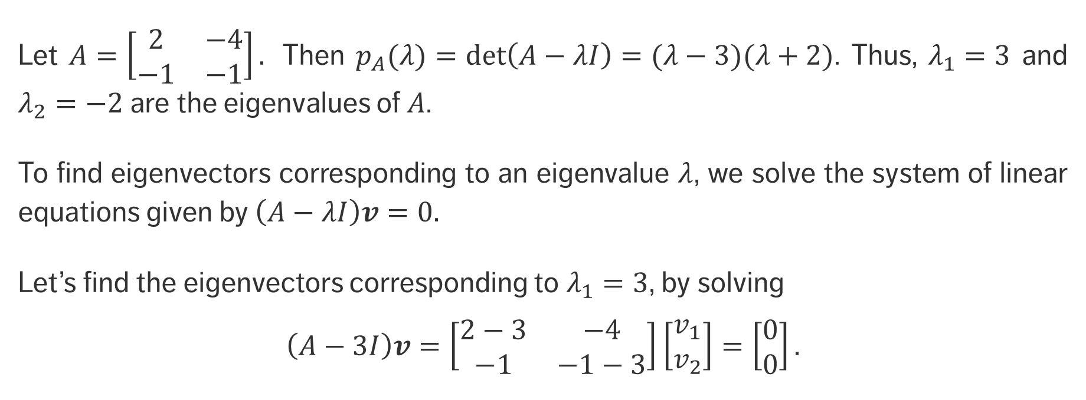
EXAMPLE
Let $A=\left[\begin{matrix}2 & −4 \\ −1 & −1\end{matrix}\right].$ Then $p_{A}(λ)=det\left(A−λI\right)=(λ−3)(λ+2)$. Thus, $λ_{1}=3$ and $λ_{2}=−2$are the eigenvalues of $A$.
To find eigenvectors corresponding to an eigenvalue $λ$, we solve the system of linear equations given by $\left(A−λI\right)v=0.$
Let’s find the eigenvectors corresponding to $λ_{1}=3$, by solving
$$\left(A−3I\right)v=\left[\begin{matrix}2−3 & −4 \\ −1 & −1−3\end{matrix}\right]\left[\begin{matrix}v_{1} \\ v_{2}\end{matrix}\right]=\left[\begin{matrix}0 \\ 0\end{matrix}\right].$$

Slide 71
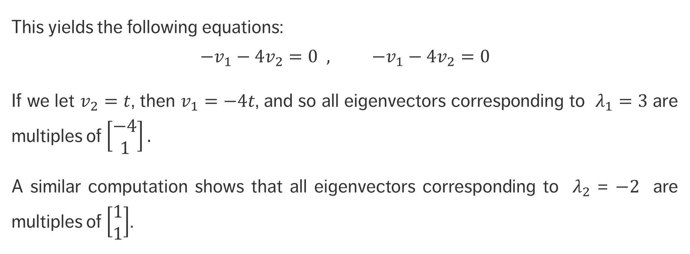
EXAMPLE
This yields the following equations:
$$−v_{1}−4v_{2}=0 , −v_{1}−4v_{2}=0$$
If we let $v_{2}=t$, then $v_{1}=−4t$, and so all eigenvectors corresponding to $λ_{1}=3$ are multiples of $\left[\begin{matrix}−4 \\ 1\end{matrix}\right].$
A similar computation shows that all eigenvectors corresponding to $λ_{2}$ = $−2$ are multiples of $\left[\begin{matrix}1 \\ 1\end{matrix}\right]$.

Slide 72
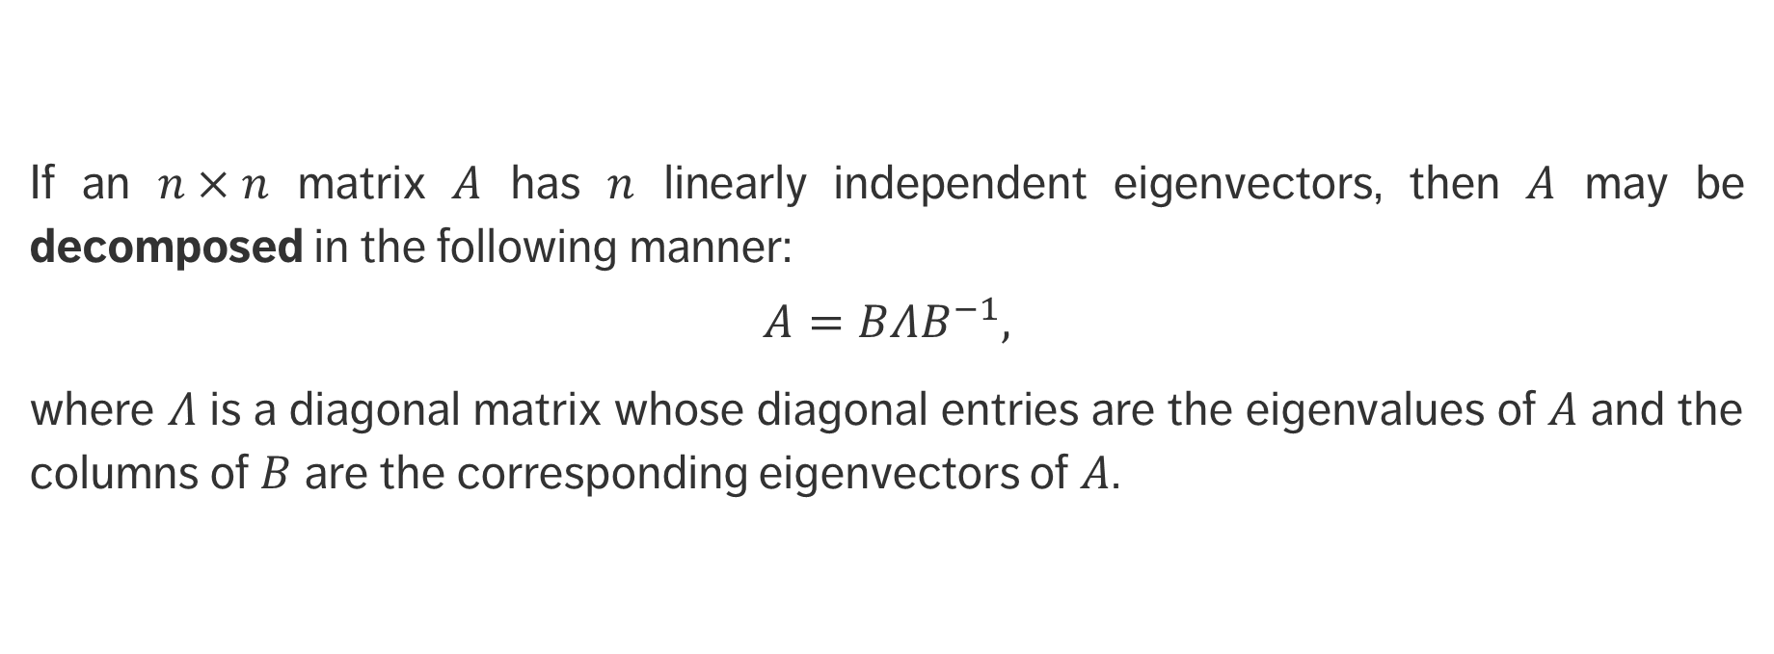
Eigen-decomposition
If an $n×n$ matrix $A$ has $n$ linearly independent eigenvectors, then $A$ may be decomposed in the following manner:
$$A=BΛB^{−1},$$
where $Λ$ is a diagonal matrix whose diagonal entries are the eigenvalues of $A$ and the columns of $B$ are the corresponding eigenvectors of $A$.

Slide 73
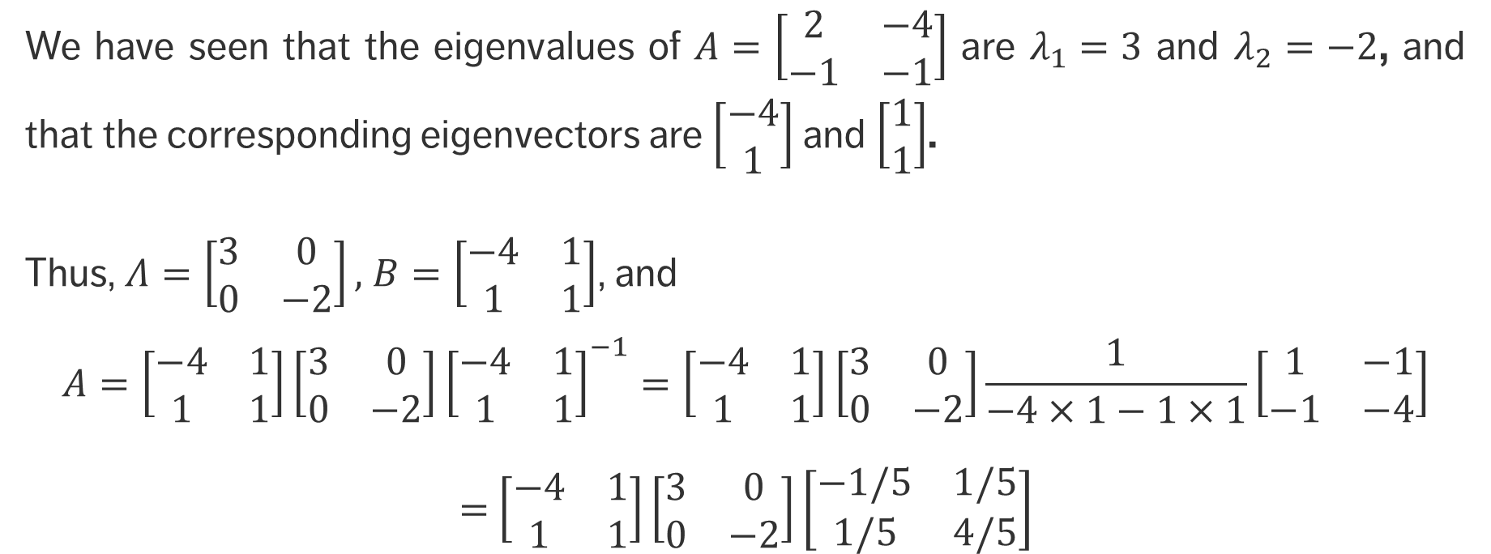
EXAMPLE
We have seen that the eigenvalues of $A=\left[\begin{matrix}2 & −4 \\ −1 & −1\end{matrix}\right]$ are $λ_{1}=3$ and $λ_{2}=−2$, and that the corresponding eigenvectors are $\left[\begin{matrix}−4 \\ 1\end{matrix}\right]$ and $\left[\begin{matrix}1 \\ 1\end{matrix}\right]$.
Thus, $Λ=\left[\begin{matrix}3 & 0 \\ 0 & −2\end{matrix}\right],$ $B=\left[\begin{matrix}−4 & 1 \\ 1 & 1\end{matrix}\right]$, and
$$A=\left[\begin{matrix}−4 & 1 \\ 1 & 1\end{matrix}\right]\left[\begin{matrix}3 & 0 \\ 0 & −2\end{matrix}\right]{\left[\begin{matrix}−4 & 1 \\ 1 & 1\end{matrix}\right]}^{−1}=\left[\begin{matrix}−4 & 1 \\ 1 & 1\end{matrix}\right]\left[\begin{matrix}3 & 0 \\ 0 & −2\end{matrix}\right]\frac{1}{−4×1−1×1}\left[\begin{matrix}1 & −1 \\ −1 & −4\end{matrix}\right]$$
$=$ $\left[\begin{matrix}−4 & 1 \\ 1 & 1\end{matrix}\right]\left[\begin{matrix}3 & 0 \\ 0 & −2\end{matrix}\right]\left[\begin{matrix}−1/5 & 1/5 \\ 1/5 & 4/5\end{matrix}\right]$

Slide 74

EXERCISES
Compute the eigen-decomposition of the matrices $A, B, C$ you constructed in the previous module.

Slide 75
REGRESSION
STATISTICAL AND MATHEMATICAL FOUNDATIONS

Slide 76
LEARNING OBJECTIVES
What is regression modelling?
What are some types of regression modeling?
When is regression modeling useful?

Slide 77
Regression Modeling
The most common data modeling methods are regressions, both linear and logistic
~90% of real data applications end up using a simple regression as their final model, typically after very careful data preparation, encoding, and creation of variables.
There are several reasons for their frequent use:
generally straightforward to understand and to train
mean square error (MSE) objective function has a closed-form linear solution
system of equations can usually be solved through matrix inversion or linear manipulation

Slide 78
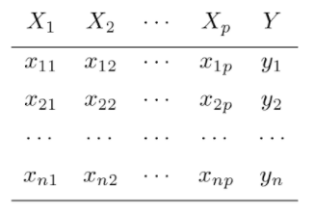
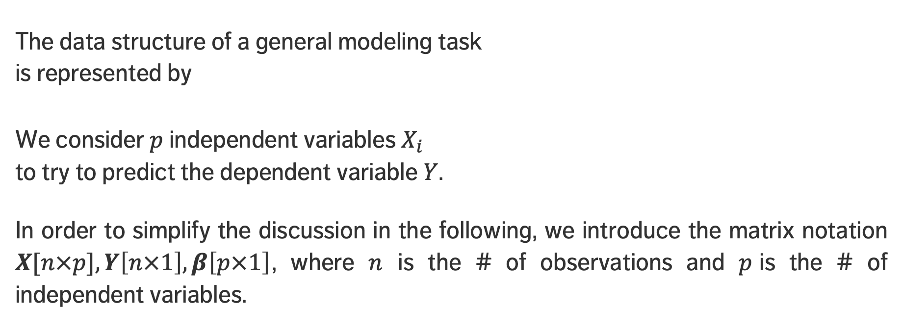
Regression Modeling
The data structure of a general modeling task is represented by
We consider $p$independent variables $X_{i}$ to try to predict the dependent variable $Y$.
In order to simplify the discussion in the following, we introduce the matrix notation $X[n×p], Y\left[n×1\right], β\left[p×1\right]$, where $n$ is the # of observations and $p$is the # of independent variables.

Slide 79
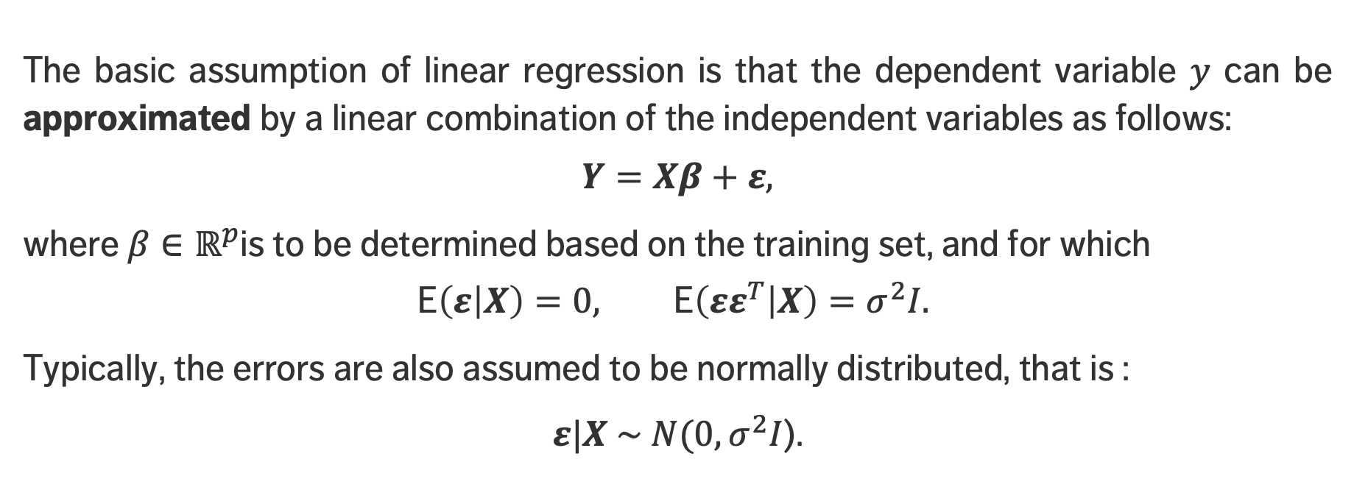
Linear Regression
The basic assumption of linear regression is that the dependent variable $y$ can be approximated by a linear combination of the independent variables as follows:
$$Y=Xβ+ε,$$
where $β∈ℝ^{p}$is to be determined based on the training set, and for which
$$\text{E}\left(ε | X\right)=0, \text{E}\left(εε^{T} | X\right)=σ^{2}I.$$
Typically, the errors are also assumed to be normally distributed, that is :
$ε|X \sim N(0, σ^{2}I$).

Slide 80

Linear Regression
If ${\hat{β}}_{i}$ is the estimate of the true coefficient $β_{i}$, the linear regression model associated with the data is
$$\hat{Y}\left(x\right)= {\hat{β}}_{0}+{\hat{β}}_{1}x_{1}+⋯+{\hat{β}}_{p}x_{p}$$
In matrix form, the regression problem requires a solution $\hat{β}$ to the normal equation $X^{T}Xβ=X^{T}Y.$
When the symmetric positive definite matrix $X^{T}X$ is invertible, the fitted coefficient is simply ${{\hat{β}=(X}^{T}X)}^{−1}{(X}^{T}Y$). Note that $X^{T}X$ is a $p×p$ matrix, which makes the inversion “easier” to compute, relatively speaking, when $n$ is large.

Slide 81

Generalized Linear Regression
Generalized linear models (GLMs) extend linear statistical models by accommodating response variables with non-normal conditional distributions.
Except for the error structure, a GLM is essentially the same as for a linear model:
$Y_{i}\sim$some distribution with mean $μ_{i}$, where$g(μ_{i}$)$= x_{i}^{T}β$
A GLM therefore consists of three parts:
a systematic component $x_{i}^{T}β$
a random component – specified distribution for $Y_{i}$
a link function $g$

Slide 82

Generalized Linear Regression
We could specify any distribution for the outcome variable $Y$…
but the mathematics of GLM work nicely only for the exponential family of distributions (most common statistical distributions fall into this family: such as the normal, binomial, Poisson, gamma, and others).
Linear regression is an example of GLM:
systematic component: $x_{i}^{T}β$
random component: $Y_{i} \sim N\left(μ_{i} , σ^{2}\right)$
link: $g\left(μ\right)=$ $μ$, the identity link

Slide 83

EXAMPLE
In the early stages of an epidemic, the rate at which new cases occur increases exponentially through time.
If $μ_{i}$ is the expected number of new cases on day $t_{i}$, a model taking the form
$μ_{i}=γ\exp\left(δt_{i}\right)$
might be appropriate. If we take the log of both sides, we get
$$\text{log}\left(μ_{i}\right)=\text{log}\left(γ\right)+ δt_{i}=β_{0}+β_{1}t_{i}={\left(1,t_{i}\right)}^{T}\left(β_{0},β_{1}\right).$$
Furthermore, since the we measure the number of new cases (a count), the Poisson distribution could be a reasonable choice.
link
systematic component
random component

Slide 84

Advantages of GLM
No need to transform $Y$ to have a normal distribution
Choice of link is separate from the choice of random component
more modeling flexibility
If link produces additive effects, no need for constant variance
Models are fitted via ML estimation
optimal properties of the estimators
Inference tools and model checks apply to other GLMs
Wald ratio test, likelihood ratio test, deviance, residuals, confidence intervals, etc.
See PROC GENMOD in SAS, or glm() in R

Slide 85

EXERCISE
An auto part is manufactured by a company once a month in lots that vary in size as demand fluctuates. The data below represent observations on lot size ($y$), and number of employee-hours of labor ($x$) for 10 recent production runs.
Fit a simple regression model $y_{i}=β_{0}+β_{1}x_{i}+ε_{i}$, where $E\left(ε_{i}\right)=0$, $E\left(ε_{i}ε_{j}\right)=0$ for $i≠j,$and $V(ε_{i}$)$=σ^{2}$ if the observations are:
$$Y={\left[73,50,128,170,87,108,135,69,148,132\right]}^{T},$$
$x={\left[30,20,60,80,40,50,60,30,70,60\right]}^{T}$.

Slide 86
OPTIMIZATION
STATISTICAL AND MATHEMATICAL FOUNDATIONS

Slide 87
LEARNING OBJECTIVES
What is optimization?
When is optimization useful?
What is a cost function?
Why are minima and maxima relevant to optimization?
What are techniques that can be used to carry out optimization?

Slide 88

Optimization
Suppose we have a cost (objective) function $f: ℝ^{n}→ℝ$to optimize (the maximum likelihood function of linear regression, for instance).
Seeking a maximum for $f$ is equivalent to seeking a minimum for –$f$.
The aim is to find parameter values $x$ that minimize this function:
$$x^{∗}=\arg{\min_{x}f\left(x\right)}$$
The cost function could be subjected to a number of constraints
$c_{i}\left(x\right)=0, i=1,…,m;{ c}_{j}\left(x\right)≥0, j=1,…,k; x∈Ω⊆ℝ^{n}$.

Slide 89

Optimization
The optimization problem can be viewed as a decision problem that involves finding the “best” vector $x$ over all possible vectors in $Ω{⊆ℝ}^{n}$.
This vector is called the minimizer of $f$ over $Ω$. There may be multiple minimizers, or none.
If $Ω{=ℝ}^{n}$, then we refer to the problem as an unconstrained optimization problem.
In general, this is not a trivial problem (consult the literature).

Slide 90
Type of Minima
local minima
In many instances, optimization is a numerical endeavour. Which of the minima is found depends on the algorithm‘s starting point.
global minimum
feasibility region

Slide 91
Golden Section Method
The golden section search is a technique for finding the extremum (minimum or maximum) of a strictly unimodal function by successively narrowing the range of values inside which the extremum is known to exist.
The technique derives its name from the fact that the algorithm maintains the function values for triples of points whose distances form a golden ratio.

Slide 92

Golden Section Method
Let $[a,b]$ be the interval of the current bracket (i.e. the optimizer resides in $[a,b]$), and assume $f(a), f(b)$have already have been computed. Denote $φ= {(1+\sqrt{5})}/2$.
Let $c=b −\frac{\left(b−a\right)}{φ} ,d=a+\frac{\left(b−a\right)}{φ};$
If $f(c), f(d)$ are not available, compute them;
If $f\left(c\right)< f(d)$(to find a min – to find a max, reverse the order) then move the data: $\left(b, f\left(b\right)\right)← \left(d, f\left(d\right)\right) and (d, f(d)) ← (c, f(c))$and update $c = b − (a − b)/φ$ and $f\left(c\right);$
Otherwise, move the data $\left(a, f\left(a\right)\right)← \left(c, f\left(c\right)\right) and (c, f(c)) ← (d, f(d))$and update $d = a + (b − a)/φ$ and $f\left(d\right);$
The interval $[c, d]$brackets the optimizer. Continue until tolerance is reached.

Slide 93

Newton’s Method
In calculus, we learn that a function $f:Ω⊆ℝ^{n}→$ $ℝ$ which is sufficiently well behaved reaches its max/min either at a critical point (i.e. where $∇f=0$) or on the domain boundary $∂Ω$.
Thus, to identify candidate optimizers, we must be able to solve general systems of the form $g(x)=0$.
Newton’s Method is a powerful method for finding roots of functions.

Slide 94

Newton’s Method
For $n=1$, the algorithm is shown below (it is quite similar in the general case).
Let $x = c$ be an (unknown) zero of a differentiable function $f$ in an open interval containing $c$.
make an initial approximation $x_{1}$“close” to $c$
determine a new approximation using the formula $x_{2}= x_{1}−\frac{f(x_{1})}{f^{′}(x_{1})}.$
If $|x_{2}−x_{1}|$is less than the desired accuracy (which needs to be specified), $x_{2}$ serves as the final approximation. Otherwise, return to step 2. and calculate a new approximation.

Slide 95

EXERCISES
Use the golden section method and Newton’s method to find a root of
$f\left(x\right)=e^{−x}\sin\left(x\right)$ and $g\left(x\right)=x\ln\left(x\right).$

Slide 96
REFERENCES
STATISTICAL AND MATHEMATICAL FOUNDATIONS

Slide 97
References
Wu, J., Coggeshall, S. [2012], Foundations of Predictive Analytics, CRC Press.
Bruce, P., Bruce, A. [2017], Practical Statistics for Data Scientists, 50 Essential Concepts, O’Reilly.
Jaynes, E.T. [2003], Probability Theory: the Logic of Science, Cambridge
https://ece.uwaterloo.ca/~dwharder/NumericalAnalysis/11Optimization/newton/
https://www.math.ucdavis.edu/~thomases/W11_16C1_lec_3_11_11.pdf
https://web.as.uky.edu/statistics/users/pbreheny/760/S13/notes/1-24.pdf
https://socialsciences.mcmaster.ca/jfox/Courses/SPIDA/GLMs-notes.pdf
https://onlinecourses.science.psu.edu/stat504/node/216
http://stattrek.com/regression/regression-example.aspx?Tutorial=AP
http://www.stat.ucla.edu/~nchristo/introeconometrics/introecon_matrix_simple_regr.pdf

Slide 98
References
http://www.personal.soton.ac.uk/jav/soton/HELM/workbooks/workbook_30/30_3_lu_decomposition.pdf
https://www.math.hmc.edu/calculus/tutorials/eigenstuff/
https://people.duke.edu/~ccc14/sta-663/LinearAlgebraMatrixDecompWithSolutions.html
https://www.georgebrown.ca/uploadedFiles/TLC/_documents/Basic%20Matrix%20Operations.pdf
https://bgsu.instructure.com/courses/901773/pages/p5-learning-using-bayes-rule?module_item_id=6367315
http://www4.stat.ncsu.edu/~bmasmith/ST371S11/Conditional-Probability-and-Independence.pdf
https://www2.isye.gatech.edu/~brani/isyebayes/bank/handout1.pdf
Joint probability distribution on Wikipedia
Multivariate normal probability distribution on Wikipedia

